Slide 1
Demonstration of Vulcan Software

Slide 2
Content
Demonstration
Introduction to Vulcan GUI
Project Description
Creation of Model
Analysis
Notes:
Outline of what is included in this presentation

Slide 3
Demonstration Objectives
Present the main features of the software
Demonstrate “live” the speed at which a model can be created
Show the software running
Present the results of the completed analysis
Notes:
Outline of what is included in this presentation

Slide 4
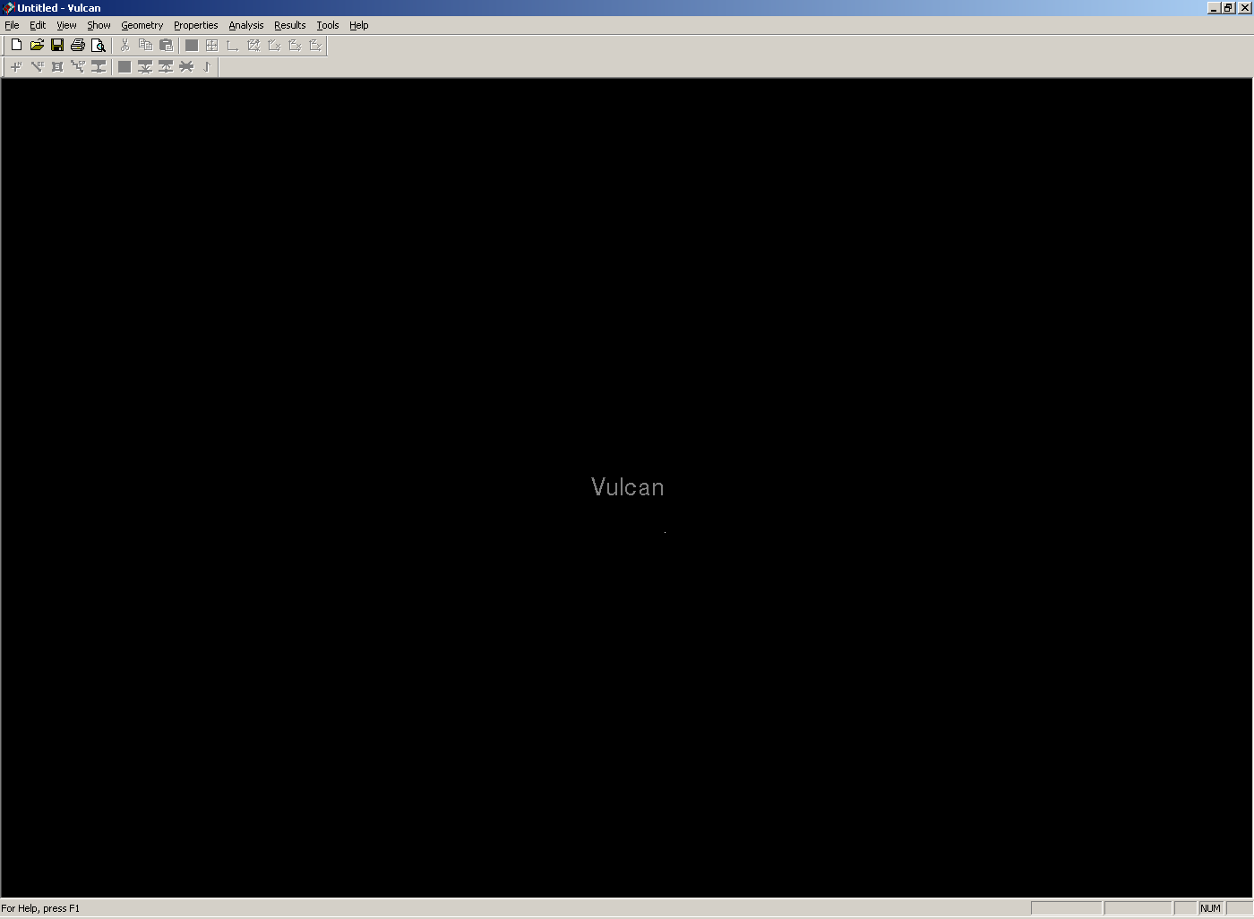
Demonstration
Notes:
General
The Vulcan application has been developed to follow the protocols of standard Windows applications. It contains many of the features, menus, tool bars and short-cuts that are common to many Windows applications.
The Vulcan application’s menus have been structured in a logical manner that leads the user progressively through each of the steps required to generate a Vulcan finite element model:
The leftmost three menus “File”, “Edit”, and “View”, contain functions that are typical to Windows applications.
‘File’ is used to Open and Save files, create New files, and Exit
‘View’ is used to display the current information in different ways – for example different planes (X-Y, X-Z etc) or 3-dimensional views can be selected. Some of these functions are also replicated on the toolbar.
Options include:
Render
Normal
Isometric
XY Plane
XZ Plane
YZ Plane
Zoom Window
Zoom Extents
The “Show” menu is specific to Vulcan and allows the user to specify which components of the finite element model are shown in the screen display.
Options include:
Axes Nodes Beams Slabs Springs Shear connectors
Hide Mid Nodes
Hide Beam Nodes
Hide Slab Nodes
Hide Spring Nodes
Slab span directions
Slab orientations
It is then anticipated that most users will start with the “Geometry” menu and work through its functions. They will then proceed to the next menu on the right (“Properties”) and work through its functions. This process will be continued until the model has been defined and is ready to be analysed.
These steps are described in more detail in the following slides.

Slide 5
Demonstration
View menu
Notes:
The View menu
‘View’ is used to display the current information in different ways – for example different planes (X-Y, X-Z etc) or 3-dimensional views can be selected. Some of these functions are also replicated on the toolbar.
The ‘Zoom extents’ command will scale the display of the currently defined structure to fit the screen.
When using the ‘window’ facility to pick a group of elements or nodes it is important to recognise that ALL items which are even PARTIALLY included within the window will be selected.
In different modes the mouse pointer takes a different form to act as a reminder – for example if the operation implicitly expects a beam to be selected, the pointer is B, whereas if a node is to be selected it is an N.

Slide 6
Demonstration Function Keys
CTRL+
Left click - Rotates Model
Middle click - Zoom Model
Right click - Pan Model
SHIFT key adds and removes from a selection
Middle click accepts the selections
Right click de-selects last last item selected
Wheel zooms model towards mouse position
Notes:
Vulcan includes standard CAD control conventions for changing the view or identifying different parts of the structure

Slide 7
Demonstration Case Study
DSS Newcastle Phase 2
Four storey office building
Six similar blocks
Composite steel framed construction
60 minute fire resistance period
Notes:
The demonstration shows how a specific project is defined – the example used is a real one, namely the DSS HQ in Newcastle.

Slide 8
Building Dimensions Define Model
1. Define Model
2. Define Protection
3. Generate Grid
4. Add Columns
5. Beam Sections
6. Beams
7. Steel Materials
8. Reinforcement Bars
9. Concrete Sections
10. Concrete Materials
11. Temperature Curves
12. Temperature Patterns
13. Boundary Conditions
14. Loading
15. Output Specification
16. Analysis Parameters
17. Options
18. Analyse
19. Results
Define representative portion of structure
Y
X
Notes:
Defining the Model – preliminary work before starting to run Vulcan
The first stage of any structural fire engineering assessment is to define the model.
This slide shows the actual floor plan of the building structure to be modelled. Structural fire analysis is a complex process and computing times can be very long. It is therefore common practice to model just part of the structure and impose appropriate boundary conditions to represent the effect of the remainder of the building on the analysed part. In this case the full width of the building has been considered, but only half of the length. The ‘cut’ in the middle of the building can then be treated as a line of symmetry.
(In more extensive buildings it may not be feasible to model even half of the building. In such cases appropriate areas can often be identified as being representative ‘worst cases’ and suitable boundary conditions applied at the edges.

Slide 9
Building Dimensions Define Model
1. Define Model
2. Define Protection
3. Generate Grid
4. Add Columns
5. Beam Sections
6. Beams
7. Steel Materials
8. Reinforcement Bars
9. Concrete Sections
10. Concrete Materials
11. Temperature Curves
12. Temperature Patterns
13. Boundary Conditions
14. Loading
15. Output Specification
16. Analysis Parameters
17. Options
18. Analyse
19. Results
Use symmetry to reduce size of analysis
Y
X
Notes:
Defining the Model – preliminary work before starting to run Vulcan
There are many consideration within this process but the most important ones include:
The performance requirements (e.g. fire resistance period) will be defined prior to starting the fire engineering analysis.
The next step is to determine how much of the structure needs to be modelled in order to accurately represent the fire performance of the structure as a whole, and whether symmetry will be used to minimise the computation demands.

Slide 10
Building Dimensions Define Protection
1. Define Model
2. Define Protection
3. Generate Grid
4. Add Columns
5. Beam Sections
6. Beams
7. Steel Materials
8. Reinforcement Bars
9. Concrete Sections
10. Concrete Materials
11. Temperature Curves
12. Temperature Patterns
13. Boundary Conditions
14. Loading
15. Output Specification
16. Analysis Parameters
17. Options
18. Analyse
19. Results
Y
X
Notes:
Defining the Model – preliminary work before starting to run Vulcan
Decide on temperature regimes for the beams and slabs. Typically the primary consideration is which beams will be protected and which beams will be unprotected and what the appropriate time-temperature relationship should be for these beams.
One common strategy is that beams framing into columns should be protected with intermediate (secondary) beams unprotected. On the diagram in the slide the following convention is used, and this is also adopted in Vulcan to visualise which parts of the structure are assumed to be heated and which are protected:
Blue - Protected Beams
Red - Unprotected Beams

Slide 11
Building Dimensions Generate Grid
1. Define Model
2. Define Protection
3. Generate Grid
4. Add Columns
5. Beam Sections
6. Beams
7. Steel Materials
8. Reinforcement Bars
9. Concrete Sections
10. Concrete Materials
11. Temperature Curves
12. Temperature Patterns
13. Boundary Conditions
14. Loading
15. Output Specification
16. Analysis Parameters
17. Options
18. Analyse
19. Results
1.6375m
6.55m
8.2m
2.05m
1.6m
3.8m
3.8m
Y
6.4m
6.4m
X
Notes:
Defining the Model – preliminary work before starting to run Vulcan - Structural Layout and Mesh
The selection of an appropriate finite element mesh density for the proposed structural grid is crucial.
It is often appropriate to conduct mesh sensitivity studies – ie to run a range of analyses with different mesh densities.
Typically, elements should be between 1.0m and 2.0m and slab elements should be approximately square.
In this instance, two meshes are used;
1.6m x 2.05m for the “South” portion of the slab (the lower part of the diagram), and
1.6m x 1.6375m for the “North” portion of the slab (the upper part of the diagram).

Slide 12
Geometry Menu Generate Grid
1. Define Model
2. Define Protection
3. Generate Grid
4. Add Columns
5. Beam Sections
6. Beams
7. Steel Materials
8. Reinforcement Bars
9. Concrete Sections
10. Concrete Materials
11. Temperature Curves
12. Temperature Patterns
13. Boundary Conditions
14. Loading
15. Output Specification
16. Analysis Parameters
17. Options
18. Analyse
19. Results
Geometry menu
Notes:
Vulcan – Geometry Menu
There are two principal ways of defining the structure. The ‘Generate Grid’ command is most convenient

Slide 13
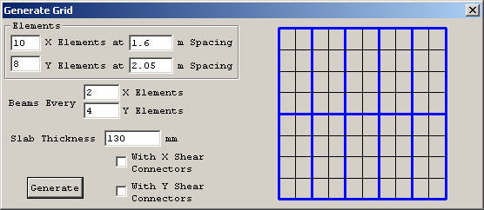
Geometry Menu Generate Grid
1. Define Model
2. Define Protection
3. Generate Grid
4. Add Columns
5. Beam Sections
6. Beams
7. Steel Materials
8. Reinforcement Bars
9. Concrete Sections
10. Concrete Materials
11. Temperature Curves
12. Temperature Patterns
13. Boundary Conditions
14. Loading
15. Output Specification
16. Analysis Parameters
17. Options
18. Analyse
19. Results
No. Elements
Spacing
Preview
Beam Frequency
Overall slab depth
Y
X
Notes:
Vulcan – Geometry Menu
Generate Grid
The finite element mesh is defined in Vulcan from the geometry menu. It is possible to generate a model node-by-node and element-by-element but this would be a lengthy and laborious process. Therefore, the “Generate Grid” function has been included to assist with the rapid generation of finite element geometries.
Select ‘Geometry’ from the main menu and click on ‘Generate Grid’.
The “Generate Grid” menu loads the dialogue box shown above.
The key components of this box are:
No. X Elements - defines the number of finite elements along the x-axis.
X-Spacing - defines the length of each element on the x-axis (usually in metres).
No. Y Elements - defines the number of finite elements along the y-axis.
Y-Spacing - defines the length of each element on the y-axis (usually in metres).
Beams every ? X Elements - defines how many slab elements to have between each beam element. It is assumed that beams are placed on all of the leftmost (x=0) and bottommost (y=0) slab elements. If this is not to be the case, they can be deleted at the next stage.
With X Shear Connectors - defines whether the beams on the x-axis are to be connected to the slab by shear connectors. If this is not ticked, it is assumed that the slab elements and beam elements share nodes thereby simulating “full” composite action between the beam and slab.
With Y Shear Connectors - as above but for beams on the y-axis.
The Preview Window. This shows the impact of the number entered in the following text boxes:
The numbers of elements in the X and Y directions define the general layout of the floor slab. If there are no slabs to be included in the analysis – for example the structure is non-composite using precast floor plans – they can be deleted later.
The general layout of the supporting beams is defined by specifying the regularity of beam elements in the two directions.
The slab thickness and number of shear connectors (only required if partial interaction is considered) is also specified here.
Once the data has been entered click ‘Generate’ to show the schematic arrangement of elements on plan. Steel beams are shown in blue, whilst the slab elements are in grey.
The numbers shown in the dialog box on this slide are the ones required to generate the example model.
An alternative approach to setting up the structural grid is to define the main nodes. This is generally a less efficient way of defining the structure than the ‘Generate Grid’ approach but might be suitable for simple framed structures (with no composite slabs to be considered). To set up using this method select the ‘Nodes’ option from the main ‘Geometry’ menu tab. Then enter the X, Y, Z coordinates (in mm units) for each successive node (it is sufficient at this stage to enter just the main grid positions representing the intersection of beams and columns). The connectivity between the nodes defined is specified using the ‘Beams’ option from the main ‘Geometry’ menu tab.

Slide 14
Geometry Menu Generate Grid
1. Define Model
2. Define Protection
3. Generate Grid
4. Add Columns
5. Beam Sections
6. Beams
7. Steel Materials
8. Reinforcement Bars
9. Concrete Sections
10. Concrete Materials
11. Temperature Curves
12. Temperature Patterns
13. Boundary Conditions
14. Loading
15. Output Specification
16. Analysis Parameters
17. Options
18. Analyse
19. Results
Spacing too large
Y
X
Notes:
Irregular Structural Grids (for simple, regular, repetitive structural layouts this stage is unnecessary)
In many instances, such as in the example model, the structural grid is not entirely regular. In the example model, the span from the South façade to the central “spine” beam is greater than the span from the spine beam to the North façade. Therefore, the spacing assumed by the Generate Grid function for the North portion of the structure is too large.
The transform function from the Geometry Menu can be used to correct this (see next slide).

Slide 15
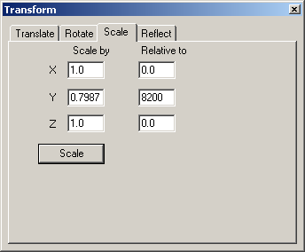
Geometry Menu Transform
1. Define Model
2. Define Protection
3. Generate Grid
4. Add Columns
5. Beam Sections
6. Beams
7. Steel Materials
8. Reinforcement Bars
9. Concrete Sections
10. Concrete Materials
11. Temperature Curves
12. Temperature Patterns
13. Boundary Conditions
14. Loading
15. Output Specification
16. Analysis Parameters
17. Options
18. Analyse
19. Results
Scale Function
Relative
Scale Factor
Y
X
Notes:
Transform (for simple, regular, repetitive structural layouts this stage is unnecessary)
The “Transform” function can be used to move, rotate, scale or reflect some or all of the elements within the model.
To reduce the spacing of the North portion of the structure, the “Scale” function can be used. This allows the user to scale parts (or all) of the finite element model in combinations of the X-, Y-, and Z-directions. In the example case, the spacing of the North portion of the structure is too large in the Y-direction.
To do this:
1. Select the “Scale” tab of the “Transform” dialogue box.
2. Enter the scale factors in the X-, Y- and Z-directions. In this instance the elements need to be scaled in the Y-direction by the required spacing (1.6375m) divided by the spacing assumed by the Generate Grid function (2.05m). This results in a factor of 0.7987.
3. Enter the position of the datum line which is to be used for the scale function. In this instance, the datum point is the spine beam which is positioned 8.2m away from the X-axis (i.e. at Y=8200).
4. Select all of the elements to be scaled (in this instance all elements to the North of the spine beam).
Scale by - is the factor to scale by in the appropriate direction.
Relative to - defines the position of the datum point about which the selected elements should be scaled.

Slide 16
Geometry Menu Transform
1. Define Model
2. Define Protection
3. Generate Grid
4. Add Columns
5. Beam Sections
6. Beams
7. Steel Materials
8. Reinforcement Bars
9. Concrete Sections
10. Concrete Materials
11. Temperature Curves
12. Temperature Patterns
13. Boundary Conditions
14. Loading
15. Output Specification
16. Analysis Parameters
17. Options
18. Analyse
19. Results
Z
X
Notes:
Adding Columns
Having defined the horizontal (floor) geometry, columns need to be added.

Slide 17
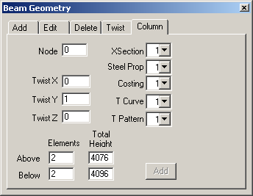
Geometry Menu Beam
1. Define Model
2. Define Protection
3. Generate Grid
4. Add Columns
5. Beam Sections
6. Beams
7. Steel Materials
8. Reinforcement Bars
9. Concrete Sections
10. Concrete Materials
11. Temperature Curves
12. Temperature Patterns
13. Boundary Conditions
14. Loading
15. Output Specification
16. Analysis Parameters
17. Options
18. Analyse
19. Results
Nodes
Column Tab
Column Properties
Twists
No. Elements
Column Height
Notes:
Defining column properties
Columns are added by selecting the ‘Beams’ option from the main ‘Geometry’ menu tab, and then selecting the ‘Column’ tab. Click on the node where a column is to be added (the corresponding node number will display in red in the main view and will also appear in the dialogue box as the ‘Node’ selected.
Then enter the total height above and below the node selected + no of elements.
Data relating to Twist (X, Y, Z), XSection, Steel Prop, Costing, T Curve, and T Pattern will be defined later.
All columns which have the same height can be defined at the same time – select multiple nodes where columns are to be defined by holding down the Shift key and clicking on successive nodes. The node numbers will accumulate in the main view (although only the last node selected will appear in the dialogue box.

Slide 18
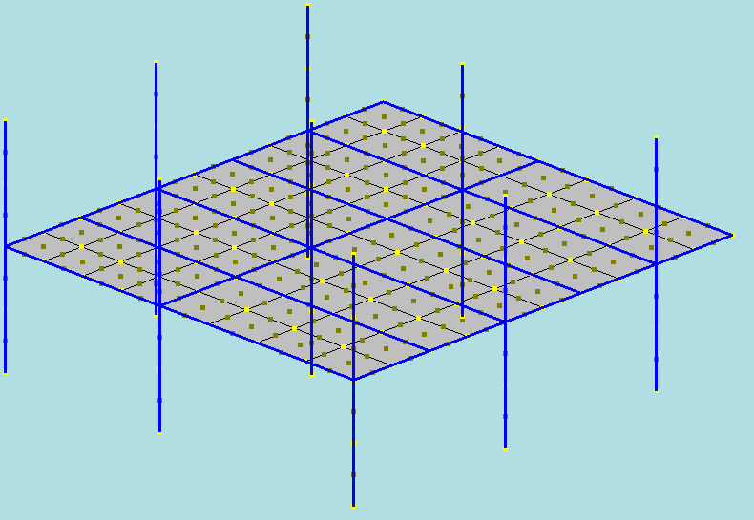
Geometry Menu Beams
1. Define Model
2. Define Protection
3. Generate Grid
4. Add Columns
5. Beam Sections
6. Beams
7. Steel Materials
8. Reinforcement Bars
9. Concrete Sections
10. Concrete Materials
11. Temperature Curves
12. Temperature Patterns
13. Boundary Conditions
14. Loading
15. Output Specification
16. Analysis Parameters
17. Options
18. Analyse
19. Results
4076
4096
Z
X
Y
Notes:
Once columns have been defined the overall layout of the structure can be viewed to check the definition is correct. This is most easily done in the isometric view (select the command ‘Isometric’ from the ‘View’ menu or click on the corresponding icon on the toolbar). All members and grid lines in this view are centre lines until members have been defined and ‘Rendered view’ option selected.

Slide 19
Properties Menu Beam Sections
1. Define Model
2. Define Protection
3. Generate Grid
4. Add Columns
5. Beam Sections
6. Beams
7. Steel Materials
8. Reinforcement Bars
9. Concrete Sections
10. Concrete Materials
11. Temperature Curves
12. Temperature Patterns
13. Boundary Conditions
14. Loading
15. Output Specification
16. Analysis Parameters
17. Options
18. Analyse
19. Results
356 x 127 x 39UB
356 x 127 x 39UB
356 x 127 x 39UB
356 x 127 x 39UB
356 x 127 x 39UB
356 x 127 x 39UB
356 x 127 x 39UB
356 x 127 x 39UB
356 x 127 x 39UB
356 x 127 x 39UB
Y
356 x 127 x 39UB
X
Notes:
Defining member sections
This slide refers to the actual floor plan and shows the standard beam section sizes used – 356x127x39UB for the main beams in the y-direction.

Slide 20
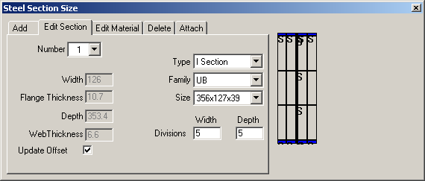
Properties Menu Beam Sections
1. Define Model
2. Define Protection
3. Generate Grid
4. Add Columns
5. Beam Sections
6. Beams
7. Steel Materials
8. Reinforcement Bars
9. Concrete Sections
10. Concrete Materials
11. Temperature Curves
12. Temperature Patterns
13. Boundary Conditions
14. Loading
15. Output Specification
16. Analysis Parameters
17. Options
18. Analyse
19. Results
Edit Section
Section Properties
Preview
Section Dimensions
Offset from slab node
Notes:
Vulcan - member sections are defined in from the Properties menu and selecting the ‘Beam sections’ menu
Members are identified by a reference number which is then attached to specific members forming the finite element model. At this stage there is no need to associate particular sections with individual members previously defined – it is simply necessary to define those sections which are to be used.
Add allows a new section to be defined. A new reference number is allocated automatically, and it is then necessary to specify the member type. A number of options are available – I section, ASB (asymmetric slimfloor beams), and non-standard (which allows users to define any shape of cross-section).
I Section is the most common and there are a number of standard sections of different families included in the Vulcan library. This allows users to define all section details simply by selecting the appropriate family (for example UB or UC) and section size.
The ‘Custom’ family allows users to define any I-section by specifying flange and web dimensions.
Edit Section – allows users to modify a previously defined section
Edit material – allows users to define the grade of steel to be used
Delete – allows users to remove a previously defined section
Attach – allows users to allocate defined sections to individual members (see later slide)

Slide 21
Properties Menu Beam Sections
1. Define Model
2. Define Protection
3. Generate Grid
4. Add Columns
5. Beam Sections
6. Beams
7. Steel Materials
8. Reinforcement Bars
9. Concrete Sections
10. Concrete Materials
11. Temperature Curves
12. Temperature Patterns
13. Boundary Conditions
14. Loading
15. Output Specification
16. Analysis Parameters
17. Options
18. Analyse
19. Results
356 x 127 x 39UB
356 x 127 x 39UB
356 x 127 x 39UB
356 x 127 x 39UB
356 x 127 x 39UB
356 x 171x 51UB
356 x 127 x 39UB
356 x 127 x 39UB
356 x 127 x 39UB
356 x 127 x 39UB
356 x 127 x 39UB
Y
356 x 171 x 51UB
X
Notes:
Defining member sections
This slide refers to the actual floor plan and shows the spine beam section size used – 356x171x51UB for the internal beams in the x-direction.

Slide 22
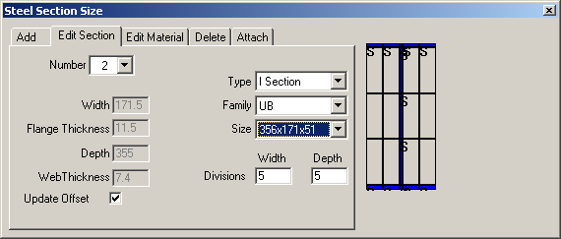
Properties Menu Beam Sections
1. Define Model
2. Define Protection
3. Generate Grid
4. Add Columns
5. Beam Sections
6. Beams
7. Steel Materials
8. Reinforcement Bars
9. Concrete Sections
10. Concrete Materials
11. Temperature Curves
12. Temperature Patterns
13. Boundary Conditions
14. Loading
15. Output Specification
16. Analysis Parameters
17. Options
18. Analyse
19. Results
Edit Section
Section Properties
Preview
Section Dimensions
Offset from slab node
Notes:
This follows an identical procedure for defining the y-direction beams

Slide 23
Properties Menu Beam Sections
1. Define Model
2. Define Protection
3. Generate Grid
4. Add Columns
5. Beam Sections
6. Beams
7. Steel Materials
8. Reinforcement Bars
9. Concrete Sections
10. Concrete Materials
11. Temperature Curves
12. Temperature Patterns
13. Boundary Conditions
14. Loading
15. Output Specification
16. Analysis Parameters
17. Options
18. Analyse
19. Results
FABSEC Beam
356 x 127 x 39UB
356 x 127 x 39UB
356 x 127 x 39UB
356 x 127 x 39UB
356 x 127 x 39UB
356 x 171x 51UB
356 x 127 x 39UB
356 x 127 x 39UB
356 x 127 x 39UB
356 x 127 x 39UB
356 x 127 x 39UB
Y
FABSEC Beam
FABSEC Beams
X
Notes:
Defining member sections
This slide refers to the actual floor plan and shows the edge beam section size used – a specially fabricated plate girder (in this case supplied by the steel company Fabsec) for the x-direction.

Slide 24
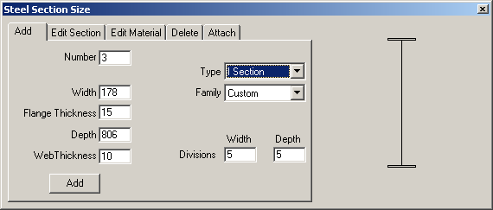
Properties Menu Beam Sections
1. Define Model
2. Define Protection
3. Generate Grid
4. Add Columns
5. Beam Sections
6. Beams
7. Steel Materials
8. Reinforcement Bars
9. Concrete Sections
10. Concrete Materials
11. Temperature Curves
12. Temperature Patterns
13. Boundary Conditions
14. Loading
15. Output Specification
16. Analysis Parameters
17. Options
18. Analyse
19. Results
Add Tab
Section Properties
Section Dimensions
Add Section
Notes:
Defining non-standard section sizes
A range of standard section sizes are included in the software, but a facility exists for adding special non-standard sections using the ‘Add’ function in the ‘Beam Section’ menu. Different types of ‘Family’ are allowed, and specific detail for a particular section are defined according to the generic type of family. In this case the section is a non-standard plate girder (comprising flanges and web), and the details of the cross-section are defined by specifying the dimensions of thes individual components.
When defined the details can be entered by clicking the ‘Add’ button.

Slide 25
Properties Menu Beam Sections
1. Define Model
2. Define Protection
3. Generate Grid
4. Add Columns
5. Beam Sections
6. Beams
7. Steel Materials
8. Reinforcement Bars
9. Concrete Sections
10. Concrete Materials
11. Temperature Curves
12. Temperature Patterns
13. Boundary Conditions
14. Loading
15. Output Specification
16. Analysis Parameters
17. Options
18. Analyse
19. Results
FABSEC Beam
356 x 127 x 39UB
356 x 127 x 39UB
356 x 127 x 39UB
356 x 127 x 39UB
356 x 127 x 39UB
Symmetry Beam
356 x 171x 51UB
356 x 127 x 39UB
356 x 127 x 39UB
356 x 127 x 39UB
356 x 127 x 39UB
356 x 127 x 39UB
Symmetry Beam
Y
FABSEC Beam
Symmetry Beams
X
Notes:
Beams on defined lines of symmetry need careful treatment. If the full beam section is used it will implicitly increase the degree of support provided to the slab along this line. To compensate for this it is necessary to reduce the effective size of the beam. This is done by defining a special beam with flange width and web thickness which are half of the actual values.

Slide 26
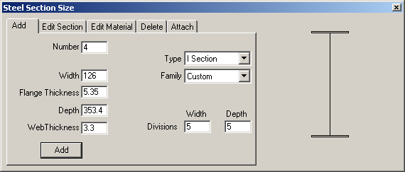
Properties Menu Beam Sections
1. Define Model
2. Define Protection
3. Generate Grid
4. Add Columns
5. Beam Sections
6. Beams
7. Steel Materials
8. Reinforcement Bars
9. Concrete Sections
10. Concrete Materials
11. Temperature Curves
12. Temperature Patterns
13. Boundary Conditions
14. Loading
15. Output Specification
16. Analysis Parameters
17. Options
18. Analyse
19. Results
Add Tab
Section Properties
Section Dimensions
Add Section
Notes:
Beams on lines of symmetry
In order to reduce the overall computation time it is often useful to define lines of symmetry on plan and to introduce appropriate boundary conditions at the nodes which are on this line. If a beam lies directly on a line of symmetry it is necessary to treat this as a special case – if the actual beam size were defined at these positions the structure would effectively be too stiff because the analysis would implicitly include the beam twice. Special beams are therefore necessary for lines of symmetry and these are defined as for plate girders using the ‘Custom’ option (see above). The simplest way to represent such beams is to use half the actual value for both flange width and web thickness.

Slide 27
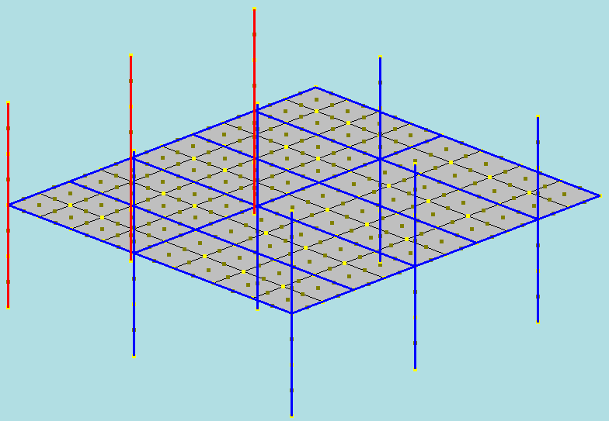
Properties Menu Beam Sections
1. Define Model
2. Define Protection
3. Generate Grid
4. Add Columns
5. Beam Sections
6. Beams
7. Steel Materials
8. Reinforcement Bars
9. Concrete Sections
10. Concrete Materials
11. Temperature Curves
12. Temperature Patterns
13. Boundary Conditions
14. Loading
15. Output Specification
16. Analysis Parameters
17. Options
18. Analyse
19. Results
Z
356 x 368 x 129UC
X
Y
Notes:
Columns are attached in a similar way.

Slide 28
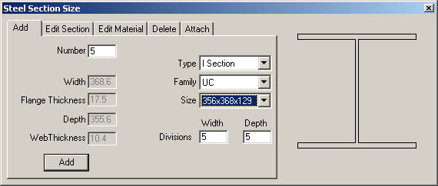
Properties Menu Beam Sections
1. Define Model
2. Define Protection
3. Generate Grid
4. Add Columns
5. Beam Sections
6. Beams
7. Steel Materials
8. Reinforcement Bars
9. Concrete Sections
10. Concrete Materials
11. Temperature Curves
12. Temperature Patterns
13. Boundary Conditions
14. Loading
15. Output Specification
16. Analysis Parameters
17. Options
18. Analyse
19. Results
Add Section
Section Properties
Preview
Section Dimensions
Add new section
Notes:
Column sections are defined in a similar manner. In many cases column sections will be taken from a different family from beams – typically UC sections.

Slide 29
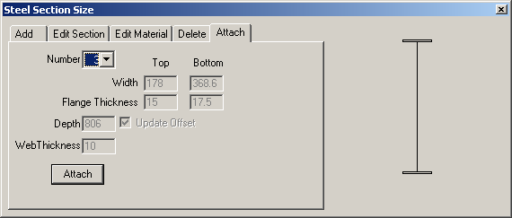
Properties Menu Beam Sections
1. Define Model
2. Define Protection
3. Generate Grid
4. Add Columns
5. Beam Sections
6. Beams
7. Steel Materials
8. Reinforcement Bars
9. Concrete Sections
10. Concrete Materials
11. Temperature Curves
12. Temperature Patterns
13. Boundary Conditions
14. Loading
15. Output Specification
16. Analysis Parameters
17. Options
18. Analyse
19. Results
Attach Tab
Preview
Attach
Notes:
Vulcan – assigning defined sections to specific elements
Having defined individual cross-section details, it is necessary to assign these to the specific parts of the structural layout to which they relate. This is done by opening the ‘Attach’ tab.
Highlight members (click ‘window’ on tool bar then stretch box or left click for individual members) – select ‘number’ to identify previously defined section to attach, then click the ‘Attach’ button in the bottom left corner of the dialogue box.
Note: When using the ‘window’ facility to pick a group of elements or nodes it is important to recognise that ALL items which are even PARTIALLY included within the window will be selected.
Once a member has been selected it is shown in red – unselected members are shown in blue.

Slide 30
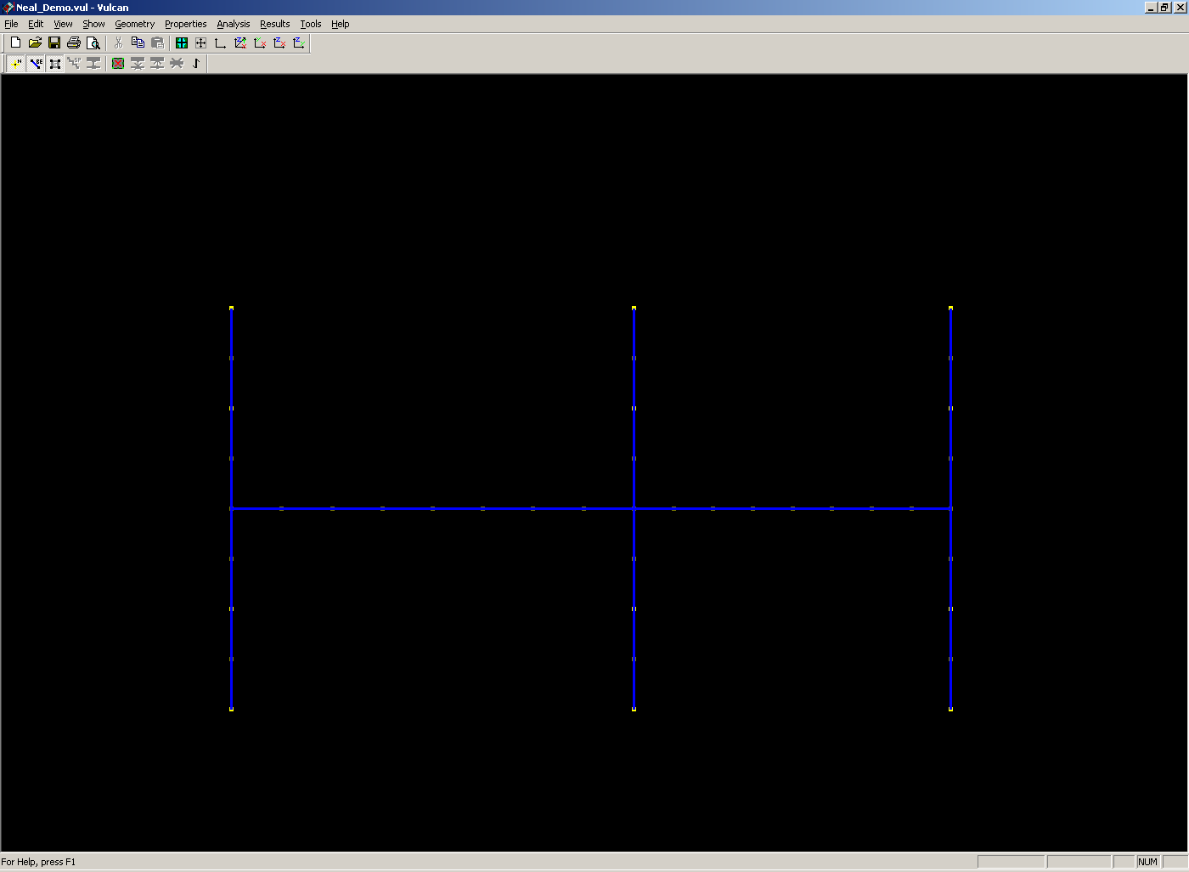
Properties Menu Beam Sections
1. Define Model
2. Define Protection
3. Generate Grid
4. Add Columns
5. Beam Sections
6. Beams
7. Steel Materials
8. Reinforcement Bars
9. Concrete Sections
10. Concrete Materials
11. Temperature Curves
12. Temperature Patterns
13. Boundary Conditions
14. Loading
15. Output Specification
16. Analysis Parameters
17. Options
18. Analyse
19. Results
Z-Y View
Notes:
Attaching beams is most conveniently done on plan view (X-Y) but attaching columns is easier in the vertical plane. ‘Pick’ all those members with the same section size as that shown in the ‘Beam properties’ dialogue box and then click on ‘Attach’ in the dialogue box (see next slide).

Slide 31
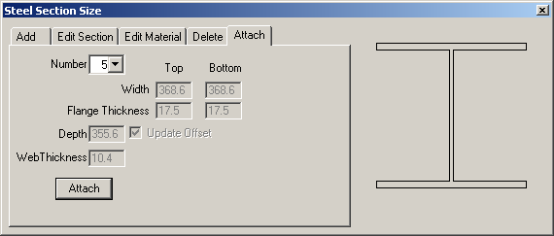
Properties Menu Beam Sections
1. Define Model
2. Define Protection
3. Generate Grid
4. Add Columns
5. Beam Sections
6. Beams
7. Steel Materials
8. Reinforcement Bars
9. Concrete Sections
10. Concrete Materials
11. Temperature Curves
12. Temperature Patterns
13. Boundary Conditions
14. Loading
15. Output Specification
16. Analysis Parameters
17. Options
18. Analyse
19. Results
Attach Tab

Slide 32
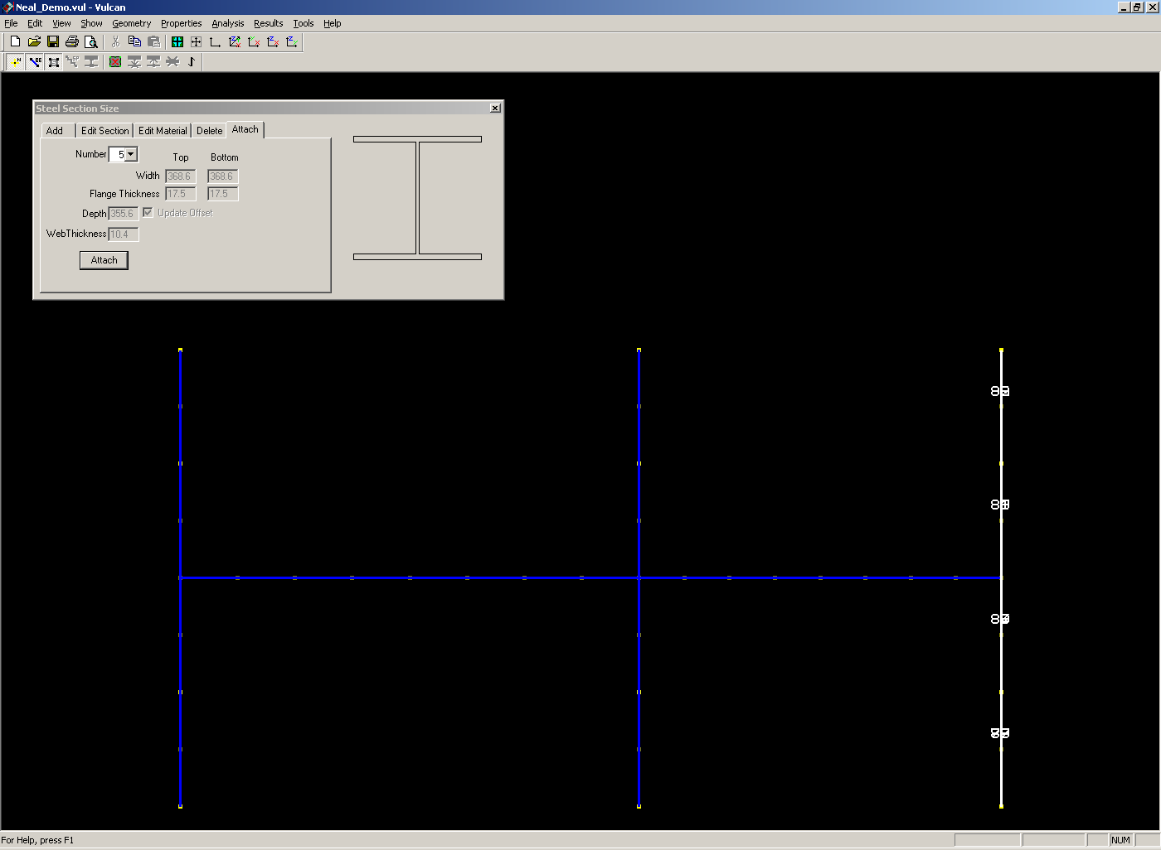
Properties Menu Beam Sections
1. Define Model
2. Define Protection
3. Generate Grid
4. Add Columns
5. Beam Sections
6. Beams
7. Steel Materials
8. Reinforcement Bars
9. Concrete Sections
10. Concrete Materials
11. Temperature Curves
12. Temperature Patterns
13. Boundary Conditions
14. Loading
15. Output Specification
16. Analysis Parameters
17. Options
18. Analyse
19. Results
Notes:
The process of attaching defined sections to individual members then continues in a similar way for all beams and columns.

Slide 33
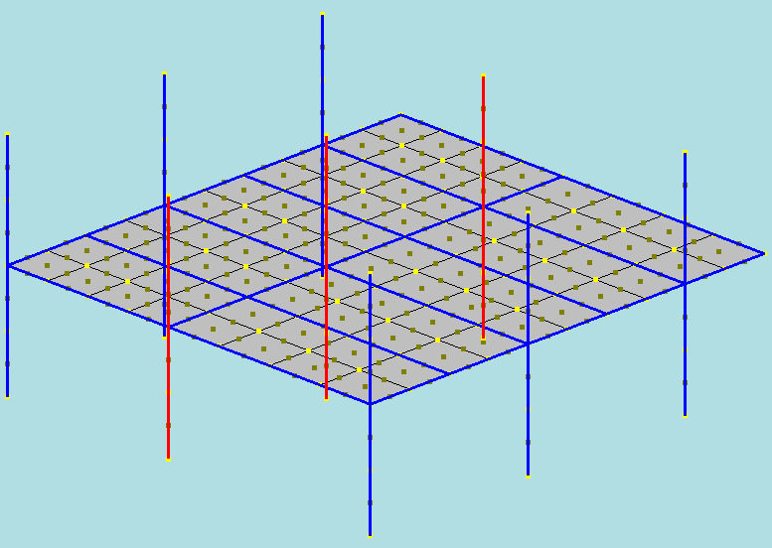
Properties Menu Beam Sections
1. Define Model
2. Define Protection
3. Generate Grid
4. Add Columns
5. Beam Sections
6. Beams
7. Steel Materials
8. Reinforcement Bars
9. Concrete Sections
10. Concrete Materials
11. Temperature Curves
12. Temperature Patterns
13. Boundary Conditions
14. Loading
15. Output Specification
16. Analysis Parameters
17. Options
18. Analyse
19. Results
Z
254 x 254 x 73UC
X
Y
Notes:
When a section (number) is selected in the ‘attach’ mode all of the members currently assigned that section size are indicated in red, providing a useful check on data entry.

Slide 34
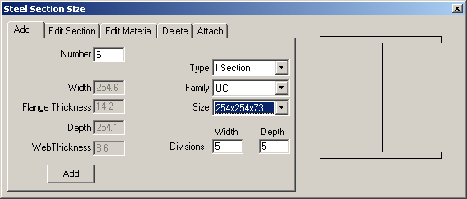
Properties Menu Beam Sections
1. Define Model
2. Define Protection
3. Generate Grid
4. Add Columns
5. Beam Sections
6. Beams
7. Steel Materials
8. Reinforcement Bars
9. Concrete Sections
10. Concrete Materials
11. Temperature Curves
12. Temperature Patterns
13. Boundary Conditions
14. Loading
15. Output Specification
16. Analysis Parameters
17. Options
18. Analyse
19. Results
Add Section
Section Properties
Preview
Section Dimensions
Add new section
Notes:
If additional member sections need to be defined this can be done at any stage. In this case the central line of columns is of a different size from the external columns and so a new section must be specified.

Slide 35
Properties Menu Beam Sections
1. Define Model
2. Define Protection
3. Generate Grid
4. Add Columns
5. Beam Sections
6. Beams
7. Steel Materials
8. Reinforcement Bars
9. Concrete Sections
10. Concrete Materials
11. Temperature Curves
12. Temperature Patterns
13. Boundary Conditions
14. Loading
15. Output Specification
16. Analysis Parameters
17. Options
18. Analyse
19. Results
Attach Tab
Notes:
..and then attached - on properties tool bar click member type to enter dialogue box (eg ‘beam sections’). Define cross-section, the click ‘attach’ tab and click on relevant members (shift click for multiple) to select.

Slide 36
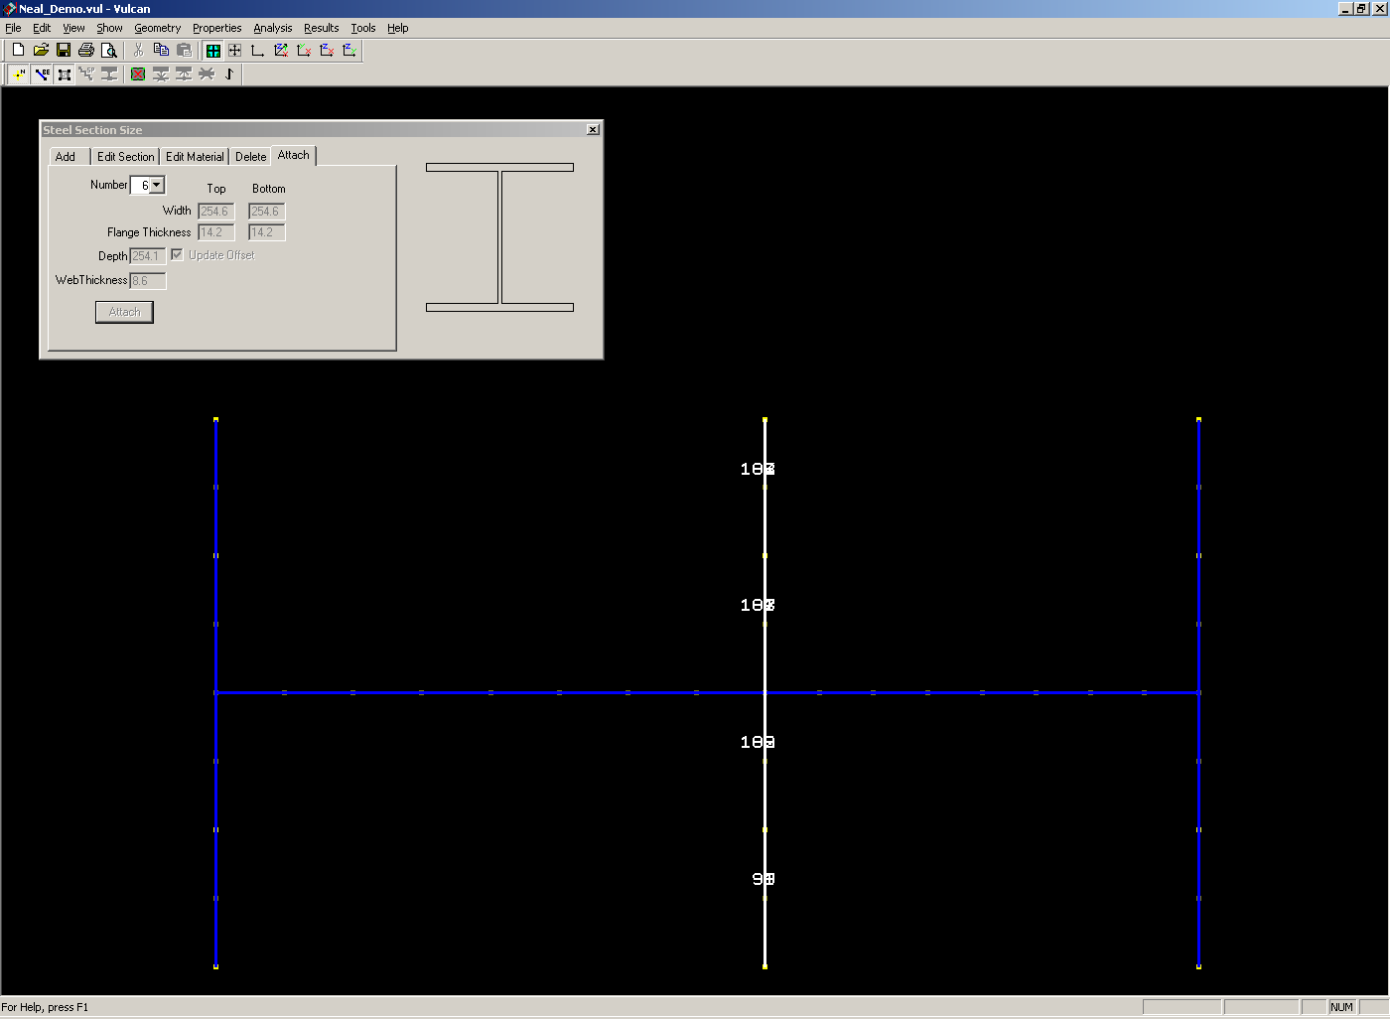
Properties Menu Beam Sections
1. Define Model
2. Define Protection
3. Generate Grid
4. Add Columns
5. Beam Sections
6. Beams
7. Steel Materials
8. Reinforcement Bars
9. Concrete Sections
10. Concrete Materials
11. Temperature Curves
12. Temperature Patterns
13. Boundary Conditions
14. Loading
15. Output Specification
16. Analysis Parameters
17. Options
18. Analyse
19. Results
Notes:
Again columns are most easily allocated on views in the vertical plane.

Slide 37
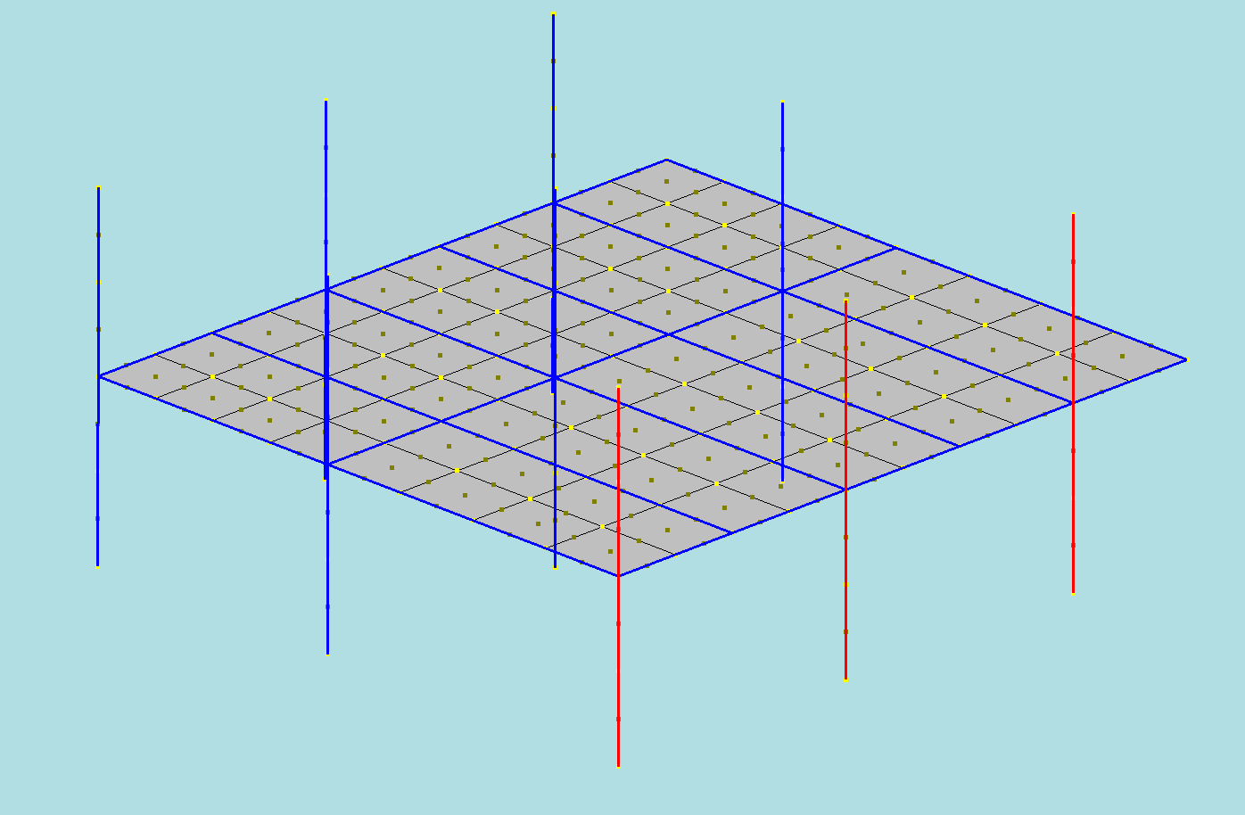
Properties Menu Beam Sections
1. Define Model
2. Define Protection
3. Generate Grid
4. Add Columns
5. Beam Sections
6. Beams
7. Steel Materials
8. Reinforcement Bars
9. Concrete Sections
10. Concrete Materials
11. Temperature Curves
12. Temperature Patterns
13. Boundary Conditions
14. Loading
15. Output Specification
16. Analysis Parameters
17. Options
18. Analyse
19. Results
Z
FABSEC Column
X
Y
Notes:
Columns need to be orientated correctly with respect to their longitudinal axis. In most cases it is simply necessary to ensure that the principal axes are correctly aligned with the connecting beams. This can be done by twisting the section, if necessary, through 90 degrees in the ‘Geometry’ menu by selecting the ‘Twist’ command from the ‘Beam section’ menu (see later slide). In this case an unusual column cross-section has been used. This is an asymmetric I section and it is therefore important that not only the principal axes are correctly aligned but that the appropriate direction is specified.

Slide 38
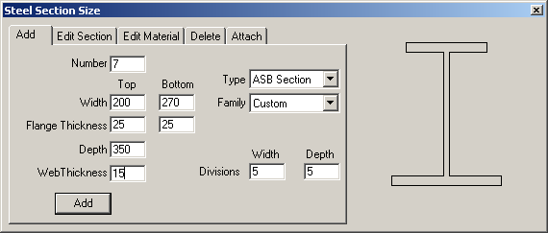
Properties Menu Beam Sections
1. Define Model
2. Define Protection
3. Generate Grid
4. Add Columns
5. Beam Sections
6. Beams
7. Steel Materials
8. Reinforcement Bars
9. Concrete Sections
10. Concrete Materials
11. Temperature Curves
12. Temperature Patterns
13. Boundary Conditions
14. Loading
15. Output Specification
16. Analysis Parameters
17. Options
18. Analyse
19. Results
Add Section
Section Properties
Preview
Section Dimensions
Add new section
Notes:
The asymmetric section is a non-standard form and is therefore defined using the ‘Custom’ facility on the ‘Beam Sections’ dialogue box in the ‘Properties’ menu.

Slide 39
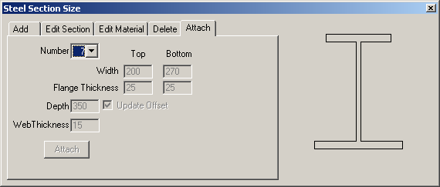
Properties Menu Beam Sections
1. Define Model
2. Define Protection
3. Generate Grid
4. Add Columns
5. Beam Sections
6. Beams
7. Steel Materials
8. Reinforcement Bars
9. Concrete Sections
10. Concrete Materials
11. Temperature Curves
12. Temperature Patterns
13. Boundary Conditions
14. Loading
15. Output Specification
16. Analysis Parameters
17. Options
18. Analyse
19. Results
Attach Tab
Notes:
The section is attached to the corresponding members as before.

Slide 40
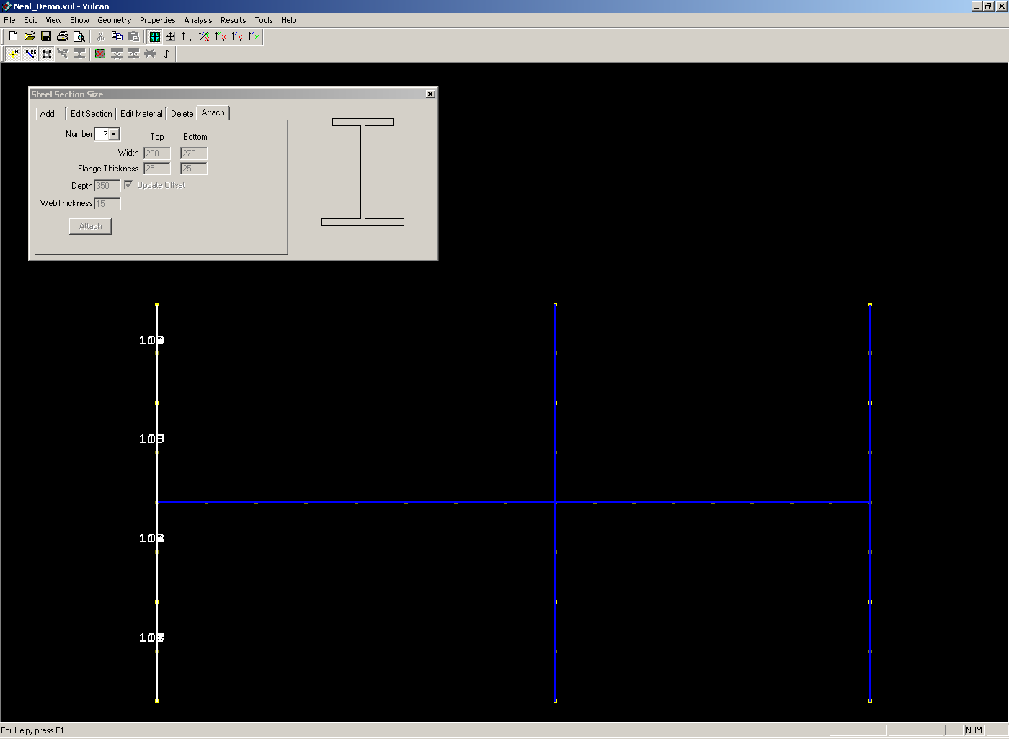
Properties Menu Beam Sections
1. Define Model
2. Define Protection
3. Generate Grid
4. Add Columns
5. Beam Sections
6. Beams
7. Steel Materials
8. Reinforcement Bars
9. Concrete Sections
10. Concrete Materials
11. Temperature Curves
12. Temperature Patterns
13. Boundary Conditions
14. Loading
15. Output Specification
16. Analysis Parameters
17. Options
18. Analyse
19. Results

Slide 41
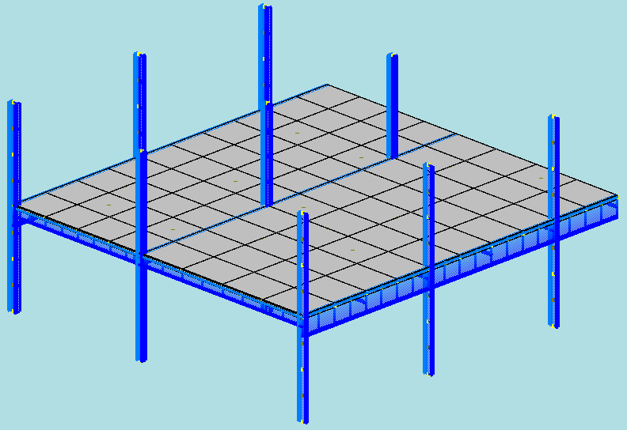
Properties Menu Beam Sections
1. Define Model
2. Define Protection
3. Generate Grid
4. Add Columns
5. Beam Sections
6. Beams
7. Steel Materials
8. Reinforcement Bars
9. Concrete Sections
10. Concrete Materials
11. Temperature Curves
12. Temperature Patterns
13. Boundary Conditions
14. Loading
15. Output Specification
16. Analysis Parameters
17. Options
18. Analyse
19. Results
Notes:
Changing alignments and offsets
The alignment of sections and the relative position of elements can be checked by viewing the structure in more detail than the simple ‘wire frame’ modelled used so far (to represent member centrelines). This shot is from ‘View’ menu using the ‘rendered’ option and shows the schematic layout of the structure and individual sections. If necessary the structure can be enlarged by zooming in.
Beams default to directly under slab and it will not normally be necessary to change this. However, some construction details such as shelf angle floor beams and slimfloor arrangements will require this to be adjusted.

Slide 42
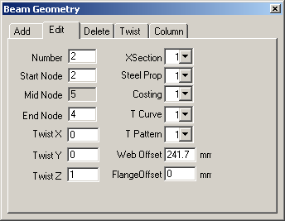
Geometry Menu Beams
1. Define Model
2. Define Protection
3. Generate Grid
4. Add Columns
5. Beam Sections
6. Beams
7. Steel Materials
8. Reinforcement Bars
9. Concrete Sections
10. Concrete Materials
11. Temperature Curves
12. Temperature Patterns
13. Boundary Conditions
14. Loading
15. Output Specification
16. Analysis Parameters
17. Options
18. Analyse
19. Results
Notes:
In order to modify the offset, select ‘Geometry’, ‘Beams’, and then the ‘Edit’ tab from the dialogue box (shown). Then select the elements to be modified by clicking the cursor on the frame view. Change the value of the offset in the appropriate entry in the dialogue box to the correct value.

Slide 43
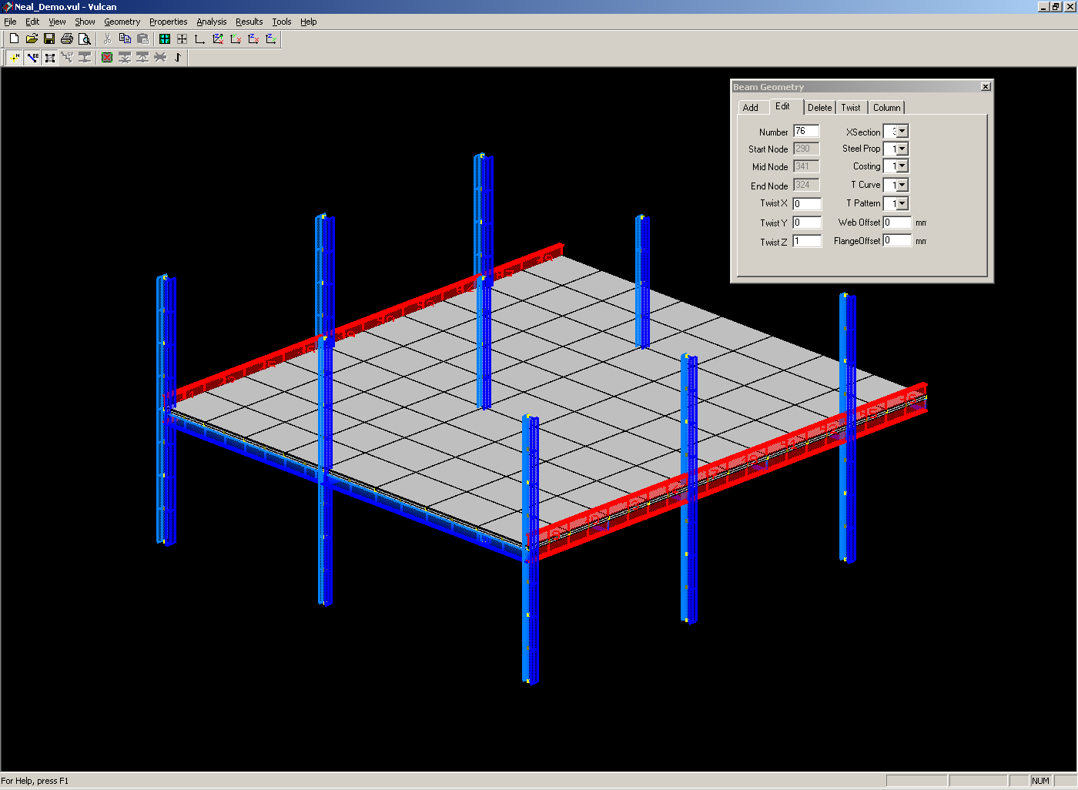
Geometry Menu Beams
1. Define Model
2. Define Protection
3. Generate Grid
4. Add Columns
5. Beam Sections
6. Beams
7. Steel Materials
8. Reinforcement Bars
9. Concrete Sections
10. Concrete Materials
11. Temperature Curves
12. Temperature Patterns
13. Boundary Conditions
14. Loading
15. Output Specification
16. Analysis Parameters
17. Options
18. Analyse
19. Results
Notes:
In this case the edge beam supports the floor slab on its bottom flange. The modified detail can be checked by viewing in the ‘render’ mode.

Slide 44
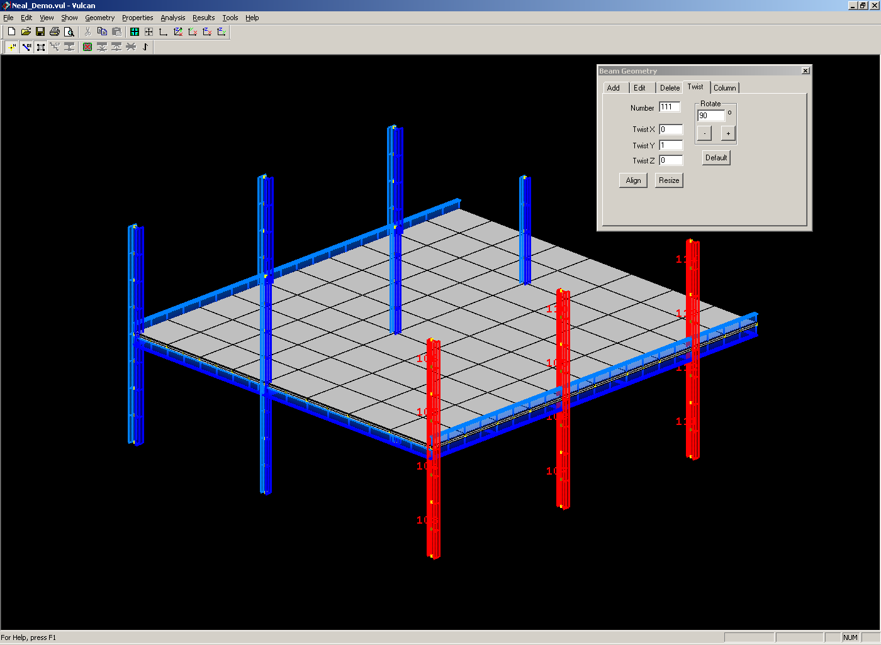
Geometry Menu Beams
1. Define Model
2. Define Protection
3. Generate Grid
4. Add Columns
5. Beam Sections
6. Beams
7. Steel Materials
8. Reinforcement Bars
9. Concrete Sections
10. Concrete Materials
11. Temperature Curves
12. Temperature Patterns
13. Boundary Conditions
14. Loading
15. Output Specification
16. Analysis Parameters
17. Options
18. Analyse
19. Results
Notes:
Column orientation is modified and checked in a similar way by - select ‘Geometry’, ‘Beams’, and then the ‘Twist’ tab from the dialogue box (shown). Then select the elements to be modified by clicking the cursor on the frame view. Change the value of the twist in the appropriate entry in the dialogue box to the correct value then click ‘+’ or ‘-’ to rotate the section.

Slide 45
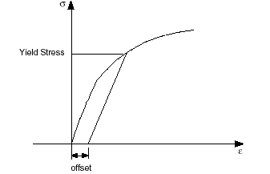
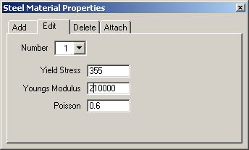
Properties Menu Steel Materials
1. Define Model
2. Define Protection
3. Generate Grid
4. Add Columns
5. Beam Sections
6. Beams
7. Steel Materials
8. Reinforcement Bars
9. Concrete Sections
10. Concrete Materials
11. Temperature Curves
12. Temperature Patterns
13. Boundary Conditions
14. Loading
15. Output Specification
16. Analysis Parameters
17. Options
18. Analyse
19. Results
Steel Grade S355
Notes:
Material properties
Having defined the structural layout and details of individual sections, material properties can be specified. Structural steel, reinforcement and concrete are all defined separately using this menu. From the ‘Properties’ menu select ‘Steel materials’ and define yield stress, Youngs modulus and Poissons ratio. If more than one type of structural steel is used these are entered separately and are identified by ‘number’.
The values defined for steel are used in the Eurocode formula (or alternative such as Ramberg-Osgood) to describe stress-strain relationships as functions of temperature.

Slide 46
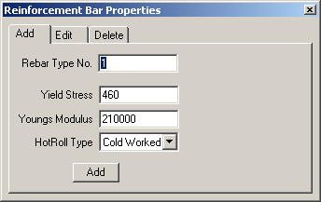
Properties Menu Reinforcement Bars
1. Define Model
2. Define Protection
3. Generate Grid
4. Add Columns
5. Beam Sections
6. Beams
7. Steel Materials
8. Reinforcement Bars
9. Concrete Sections
10. Concrete Materials
11. Temperature Curves
12. Temperature Patterns
13. Boundary Conditions
14. Loading
15. Output Specification
16. Analysis Parameters
17. Options
18. Analyse
19. Results
Add Tab
Add New Type
Notes:
Reinforcement material properties are defined in a similar manner.

Slide 47
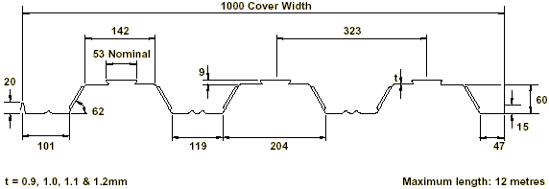
Properties Menu Concrete Sections
1. Define Model
2. Define Protection
3. Generate Grid
4. Add Columns
5. Beam Sections
6. Beams
7. Steel Materials
8. Reinforcement Bars
9. Concrete Sections
10. Concrete Materials
11. Temperature Curves
12. Temperature Patterns
13. Boundary Conditions
14. Loading
15. Output Specification
16. Analysis Parameters
17. Options
18. Analyse
19. Results
Wards Multideck 60
Slab Depth = 130mm
Mesh is A193
130mm
Notes:
This slide shows the actual cross-section through the composite floor slab – this needs to be idealised as an equivalent flat slab of uniform thickness – and in particular the position of the reinforcement must be defined.

Slide 48
Properties Menu Concrete Sections
1. Define Model
2. Define Protection
3. Generate Grid
4. Add Columns
5. Beam Sections
6. Beams
7. Steel Materials
8. Reinforcement Bars
9. Concrete Sections
10. Concrete Materials
11. Temperature Curves
12. Temperature Patterns
13. Boundary Conditions
14. Loading
15. Output Specification
16. Analysis Parameters
17. Options
18. Analyse
19. Results
A193 Mesh means that there is 193mm² of mesh per metre length of slab in each direction.
The mesh is modelled as two smeared layers across the length of the slab spanning in opposite directions.
The thickness of each layer is calculated such that they have an area of 193mm²/m. In other words each layer is 0.193mm thick.
Notes:
Modelling reinforcement layers
Reinforcement is idealised as a continuous layer of steel within the concrete slab. The thickness of the layer is such that the net area of reinforcement is the same as the cross-section area of the continuous layer. It is also important to remember that slabs will normally be considered as reinforced in both directions.

Slide 49
Properties Menu Concrete Sections
1. Define Model
2. Define Protection
3. Generate Grid
4. Add Columns
5. Beam Sections
6. Beams
7. Steel Materials
8. Reinforcement Bars
9. Concrete Sections
10. Concrete Materials
11. Temperature Curves
12. Temperature Patterns
13. Boundary Conditions
14. Loading
15. Output Specification
16. Analysis Parameters
17. Options
18. Analyse
19. Results
65.000 mm
52.000 mm
39.000 mm
25.000 mm
24.807 mm
24.614 mm
130mm
13.000 mm
0.000 mm
-13.000 mm
-26.000 mm
-39.000 mm
-52.000 mm
-65.000 mm
Notes:
This slide shows an idealised representation of the slab into layers, each of which will be assumed to have a uniform temperature and material properties). Additional thin layers have been included at appropriate levels to represent the two layers of reinforcement.

Slide 50
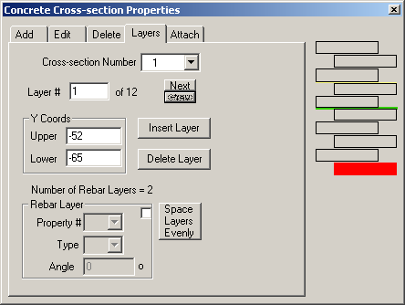
Properties Menu Concrete Sections
1. Define Model
2. Define Protection
3. Generate Grid
4. Add Columns
5. Beam Sections
6. Beams
7. Steel Materials
8. Reinforcement Bars
9. Concrete Sections
10. Concrete Materials
11. Temperature Curves
12. Temperature Patterns
13. Boundary Conditions
14. Loading
15. Output Specification
16. Analysis Parameters
17. Options
18. Analyse
19. Results
Notes:
Defining the slab section in Vulcan – the ‘Concrete sections’ dialogue box from the ‘Properties’ menu
The software defaults to an even distribution of layer thicknesses – individual layers can be changed in thickness, for example to represent the reinforcement.
The schematic view through the cross-section highlights the current layer in red, and shows the mid-depth in green.

Slide 51
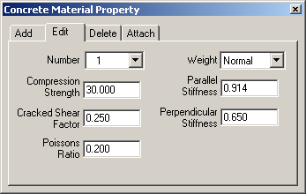
Properties Menu Concrete Materials
1. Define Model
2. Define Protection
3. Generate Grid
4. Add Columns
5. Beam Sections
6. Beams
7. Steel Materials
8. Reinforcement Bars
9. Concrete Sections
10. Concrete Materials
11. Temperature Curves
12. Temperature Patterns
13. Boundary Conditions
14. Loading
15. Output Specification
16. Analysis Parameters
17. Options
18. Analyse
19. Results
Notes:
Defining concrete properties in Vulcan – ‘Properties’ menu and the ‘Concrete materials’ dialogue box.
The concrete properties are defined in terms of compression strength, weight, and Poissons ratio. These are used to represent the stress-strain-temperature relationship, defined in accordance with EC4.
Two different generic types of concrete are included - lightweight concrete (LWC) and normal weight concrete (NWC) – each having a different function relating the parameters to alternative stress-strain-temperature curves. The actual weight of the concrete is not included in the analysis and should be defined as part of the loading.
The stiffness boxes allow a representation of the orthotropic characteristics of a composite deck floor, which has significantly stiffer properties parallel to the ribs than it does in the perpendicular direction.

Slide 52
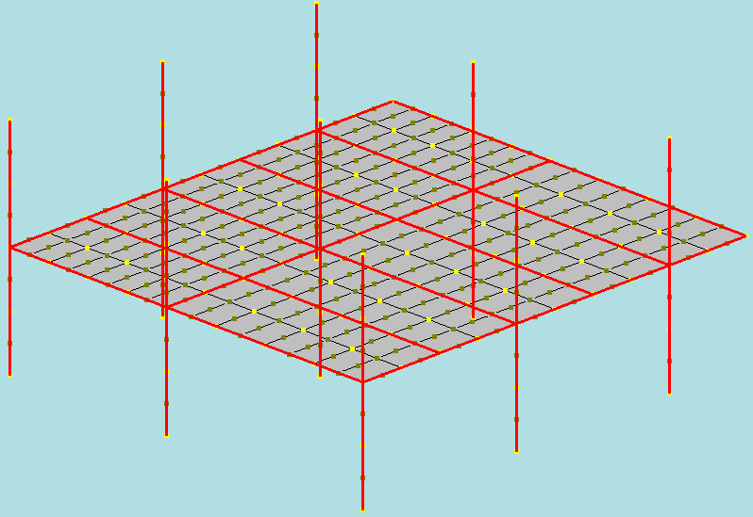
Properties Menu Temperature Curves
1. Define Model
2. Define Protection
3. Generate Grid
4. Add Columns
5. Beam Sections
6. Beams
7. Steel Materials
8. Reinforcement Bars
9. Concrete Sections
10. Concrete Materials
11. Temperature Curves
12. Temperature Patterns
13. Boundary Conditions
14. Loading
15. Output Specification
16. Analysis Parameters
17. Options
18. Analyse
19. Results
Z
Cold Structure
X
Y
Notes:
Defining temperature patterns
Two aspects of temperature need to be defined – the time-temperature relationship for the fire, and the temperature profile through individual sections. The procedure involves defining particular temperature regimes and then applying these to groups of members with common temperature regimes.

Slide 53
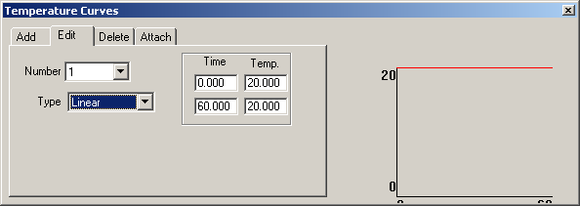
Properties Menu Temperature Curves
1. Define Model
2. Define Protection
3. Generate Grid
4. Add Columns
5. Beam Sections
6. Beams
7. Steel Materials
8. Reinforcement Bars
9. Concrete Sections
10. Concrete Materials
11. Temperature Curves
12. Temperature Patterns
13. Boundary Conditions
14. Loading
15. Output Specification
16. Analysis Parameters
17. Options
18. Analyse
19. Results
Edit Tab
Temperatures
Preview
Profile Shape
Cold structure is defined as remaining at ambient temperature for the duration of the fire.
Notes:
Define temperature curve (time temps)
A number of common relationships are available for selection from an integral library. Other time-temperature relations can be added.
The ‘cold’ structure is that part which is outside the immediate fire compartment, and is defined as remaining at 20C throughout. This is one example of a linear time-temperature case (in which the temperature in fact is constant).

Slide 54
Properties Menu Temperature Curves
1. Define Model
2. Define Protection
3. Generate Grid
4. Add Columns
5. Beam Sections
6. Beams
7. Steel Materials
8. Reinforcement Bars
9. Concrete Sections
10. Concrete Materials
11. Temperature Curves
12. Temperature Patterns
13. Boundary Conditions
14. Loading
15. Output Specification
16. Analysis Parameters
17. Options
18. Analyse
19. Results
Y
Unprotected Beams
X
Notes:
Model of unprotected beam group
Unprotected steel will have a relatively rapid temperature increase. At present Vulcan does not provide a means for analysing the temperature rise for heated components, but a variety of alternative ways are available for these to be specified.

Slide 55
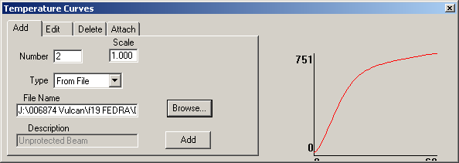
Properties Menu Temperature Curves
1. Define Model
2. Define Protection
3. Generate Grid
4. Add Columns
5. Beam Sections
6. Beams
7. Steel Materials
8. Reinforcement Bars
9. Concrete Sections
10. Concrete Materials
11. Temperature Curves
12. Temperature Patterns
13. Boundary Conditions
14. Loading
15. Output Specification
16. Analysis Parameters
17. Options
18. Analyse
19. Results
Add Tab
Preview
Profile Shape
Select File
Add
Notes:
Vulcan – specifying time-temperature relationships for heated members
Unprotected beams approximately follow the temperature of the Standard Fire Curve with a slight reduction due to the thermal inertia of the steel. In this case the temperatures were determined using a simple thermal model based on the equations in the Eurocodes.

Slide 56
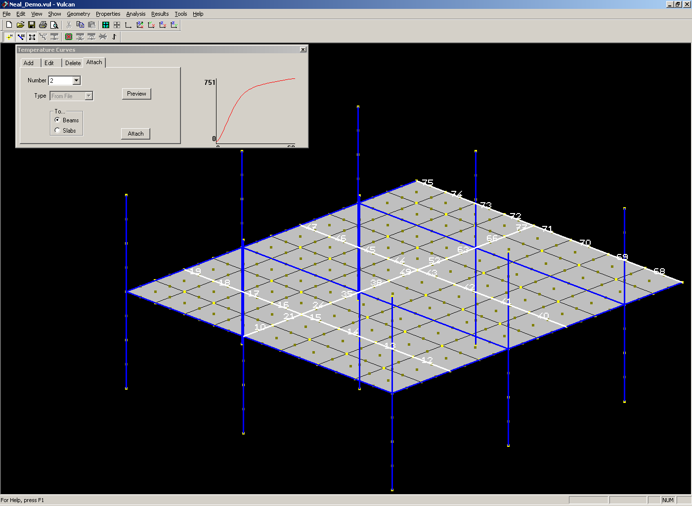
Properties Menu Temperature Curves
1. Define Model
2. Define Protection
3. Generate Grid
4. Add Columns
5. Beam Sections
6. Beams
7. Steel Materials
8. Reinforcement Bars
9. Concrete Sections
10. Concrete Materials
11. Temperature Curves
12. Temperature Patterns
13. Boundary Conditions
14. Loading
15. Output Specification
16. Analysis Parameters
17. Options
18. Analyse
19. Results
Notes:
Attaching time-temperature curves to individual parts of the structure
This is done in a similar way to specifying section details and material properties for individual members. Select members which for a group with similar characteristics, then ‘attach’ the corresponding temperature curve from the ‘Temperature Curve’ dialogue box.

Slide 57
Properties Menu Temperature Curves
1. Define Model
2. Define Protection
3. Generate Grid
4. Add Columns
5. Beam Sections
6. Beams
7. Steel Materials
8. Reinforcement Bars
9. Concrete Sections
10. Concrete Materials
11. Temperature Curves
12. Temperature Patterns
13. Boundary Conditions
14. Loading
15. Output Specification
16. Analysis Parameters
17. Options
18. Analyse
19. Results
Y
Protected Beams
X
Notes:
This process is repeated for members with different temperature curves – in this case the layout shows the location of protected beams (which will have a much slower rate of temperature increase).

Slide 58
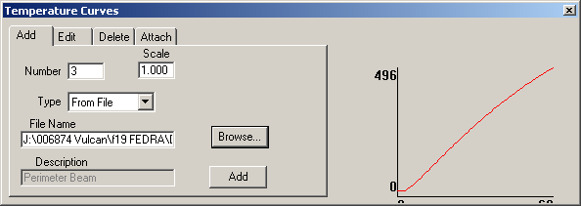
Properties Menu Temperature Curves
1. Define Model
2. Define Protection
3. Generate Grid
4. Add Columns
5. Beam Sections
6. Beams
7. Steel Materials
8. Reinforcement Bars
9. Concrete Sections
10. Concrete Materials
11. Temperature Curves
12. Temperature Patterns
13. Boundary Conditions
14. Loading
15. Output Specification
16. Analysis Parameters
17. Options
18. Analyse
19. Results
Add Tab
Preview
Profile Shape
Select File
Add
Notes:
Attaching details of time-temps curves for protected beams
As an alternative to specifying temperature curves for a particular set of members, the temperatures can simply be read directly from a text file. In this case the temperature for the protected beams is based on test data, and the file name is specified. The ‘preview’ shows a graphical interpretation of this data.
An alternative might be to assume a temperature of 620°C at the required fire resistance period as this is the basis on which suppliers determine protection thicknesses. The temperature curve can then be constructed assuming a linear increase from 20C to 620C over the fire resistance time.

Slide 59
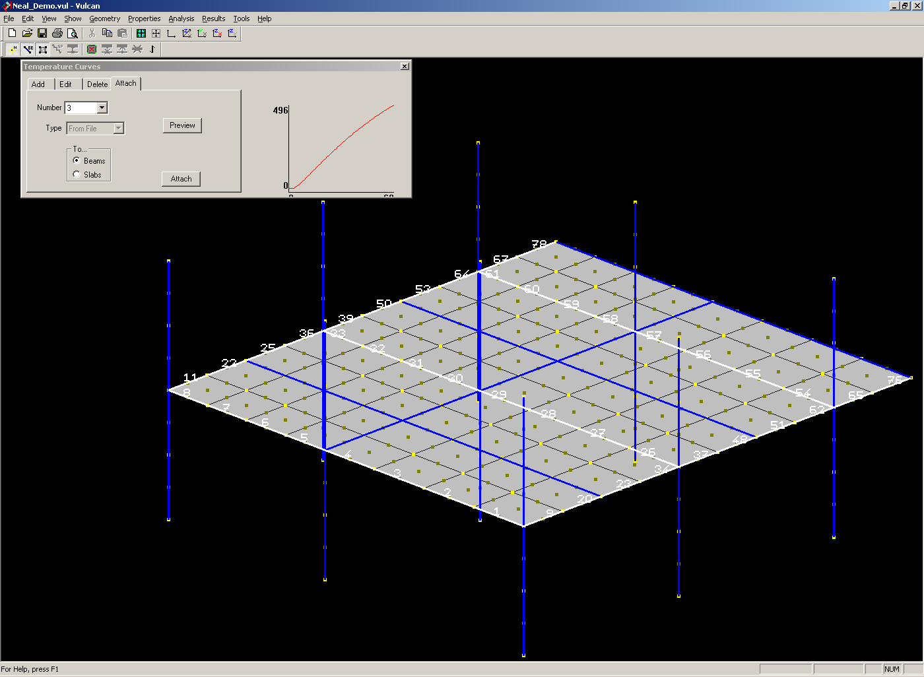
Properties Menu Temperature Curves
1. Define Model
2. Define Protection
3. Generate Grid
4. Add Columns
5. Beam Sections
6. Beams
7. Steel Materials
8. Reinforcement Bars
9. Concrete Sections
10. Concrete Materials
11. Temperature Curves
12. Temperature Patterns
13. Boundary Conditions
14. Loading
15. Output Specification
16. Analysis Parameters
17. Options
18. Analyse
19. Results
Notes:
Temperature curves are attached as before – in this case for the protected grid line beams

Slide 60
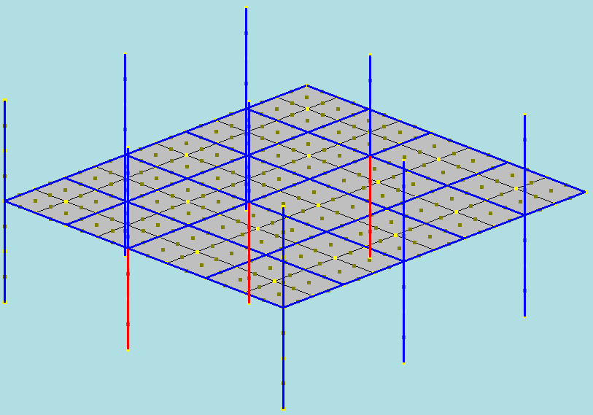
Properties Menu Temperature Curves
1. Define Model
2. Define Protection
3. Generate Grid
4. Add Columns
5. Beam Sections
6. Beams
7. Steel Materials
8. Reinforcement Bars
9. Concrete Sections
10. Concrete Materials
11. Temperature Curves
12. Temperature Patterns
13. Boundary Conditions
14. Loading
15. Output Specification
16. Analysis Parameters
17. Options
18. Analyse
19. Results
Z
Protected Columns
X
Y
Notes:
The same process follows for columns

Slide 61
Properties Menu Temperature Curves
1. Define Model
2. Define Protection
3. Generate Grid
4. Add Columns
5. Beam Sections
6. Beams
7. Steel Materials
8. Reinforcement Bars
9. Concrete Sections
10. Concrete Materials
11. Temperature Curves
12. Temperature Patterns
13. Boundary Conditions
14. Loading
15. Output Specification
16. Analysis Parameters
17. Options
18. Analyse
19. Results
Add Tab
Preview
Profile Shape
Select File
Add
Notes:
In this case the protected columns have been assumed to reach 550ºC at the fire resistance time of 60 minutes (as this is the basis on which suppliers determine protection thicknesses) with a linear increase from 20C in that time.

Slide 62
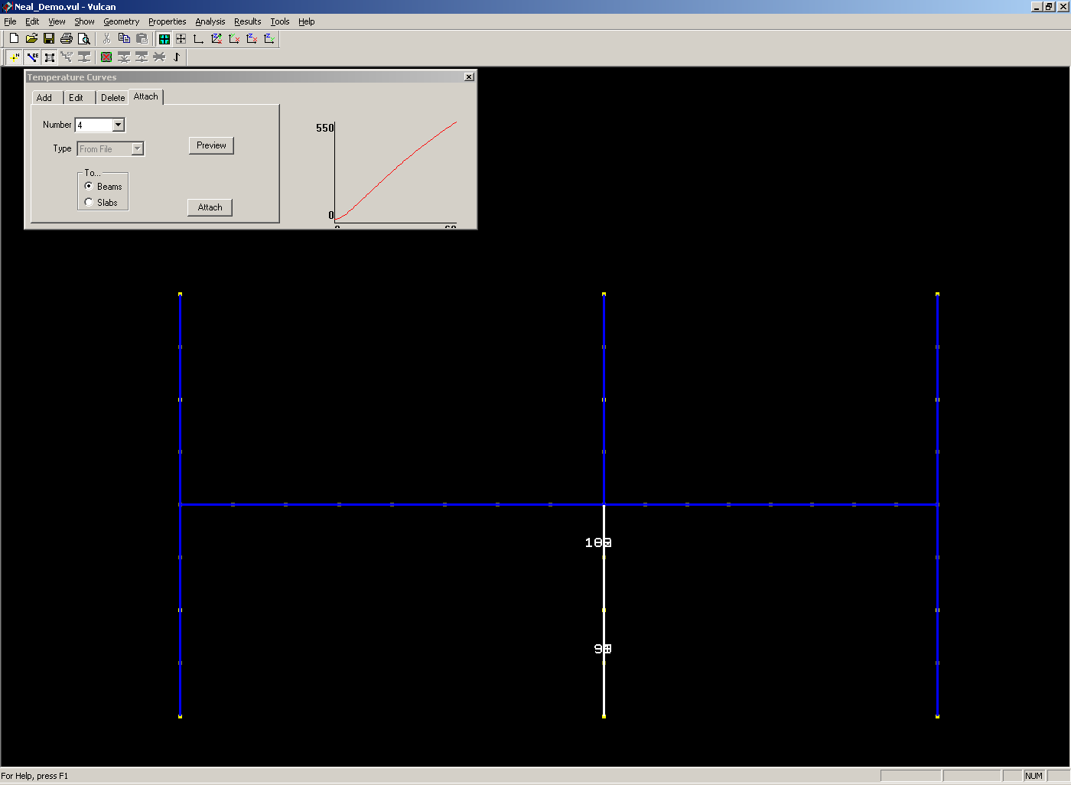
Properties Menu Temperature Curves
1. Define Model
2. Define Protection
3. Generate Grid
4. Add Columns
5. Beam Sections
6. Beams
7. Steel Materials
8. Reinforcement Bars
9. Concrete Sections
10. Concrete Materials
11. Temperature Curves
12. Temperature Patterns
13. Boundary Conditions
14. Loading
15. Output Specification
16. Analysis Parameters
17. Options
18. Analyse
19. Results
Notes:
The temperature curves are attached as before. For columns this is best done in the vertical plane view.

Slide 63
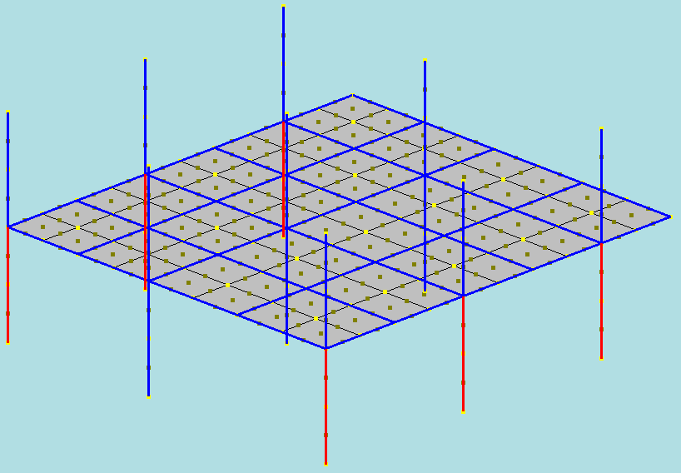
Properties Menu Temperature Curves
1. Define Model
2. Define Protection
3. Generate Grid
4. Add Columns
5. Beam Sections
6. Beams
7. Steel Materials
8. Reinforcement Bars
9. Concrete Sections
10. Concrete Materials
11. Temperature Curves
12. Temperature Patterns
13. Boundary Conditions
14. Loading
15. Output Specification
16. Analysis Parameters
17. Options
18. Analyse
19. Results
Z
Perimeter Columns
X
Y
Notes:
Perimeter columns often have a slower temperature increase because they are shielded from the fire or may be external to the building envelope.

Slide 64
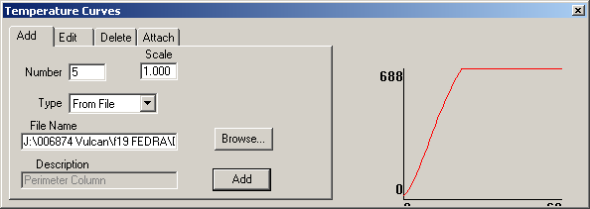
Properties Menu Temperature Curves
1. Define Model
2. Define Protection
3. Generate Grid
4. Add Columns
5. Beam Sections
6. Beams
7. Steel Materials
8. Reinforcement Bars
9. Concrete Sections
10. Concrete Materials
11. Temperature Curves
12. Temperature Patterns
13. Boundary Conditions
14. Loading
15. Output Specification
16. Analysis Parameters
17. Options
18. Analyse
19. Results
Add Tab
Preview
Profile Shape
Select File
Add
Notes:
In this case the perimeter columns are external to the envelope and are unprotected. The maximum temperature of the perimeter columns was determined to be 688C using the Law and O’Brien external steelwork calculations. The temperature rise is based on a burn-out period of 20 minutes with a linear increase from 20C up to this plateau.

Slide 65
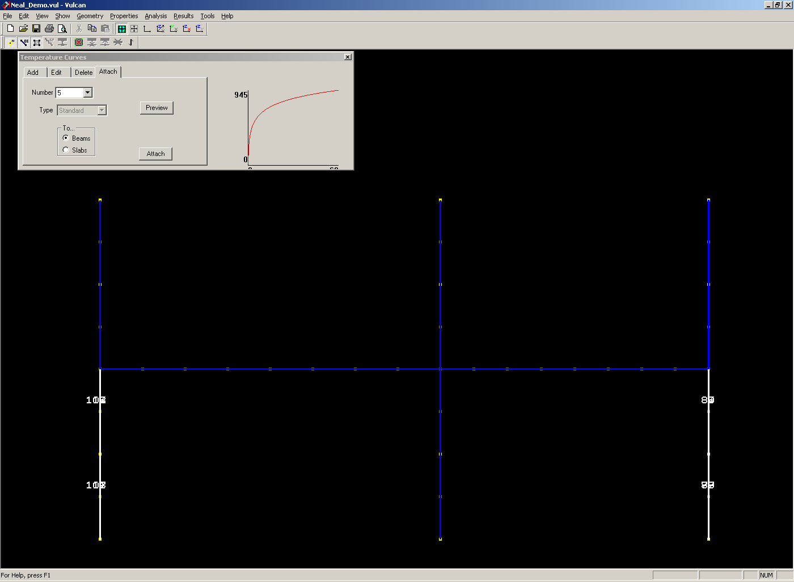
Properties Menu Temperature Curves
1. Define Model
2. Define Protection
3. Generate Grid
4. Add Columns
5. Beam Sections
6. Beams
7. Steel Materials
8. Reinforcement Bars
9. Concrete Sections
10. Concrete Materials
11. Temperature Curves
12. Temperature Patterns
13. Boundary Conditions
14. Loading
15. Output Specification
16. Analysis Parameters
17. Options
18. Analyse
19. Results
Notes:
Temperature curves are attached as before.

Slide 66
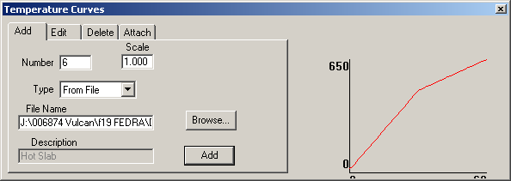
Properties Menu Temperature Curves
1. Define Model
2. Define Protection
3. Generate Grid
4. Add Columns
5. Beam Sections
6. Beams
7. Steel Materials
8. Reinforcement Bars
9. Concrete Sections
10. Concrete Materials
11. Temperature Curves
12. Temperature Patterns
13. Boundary Conditions
14. Loading
15. Output Specification
16. Analysis Parameters
17. Options
18. Analyse
19. Results
Add Tab
Preview
Profile Shape
Select File
Add
Notes:
In this case slab temperatures are based on experimental data and the temperatures are read from the specified file.

Slide 67
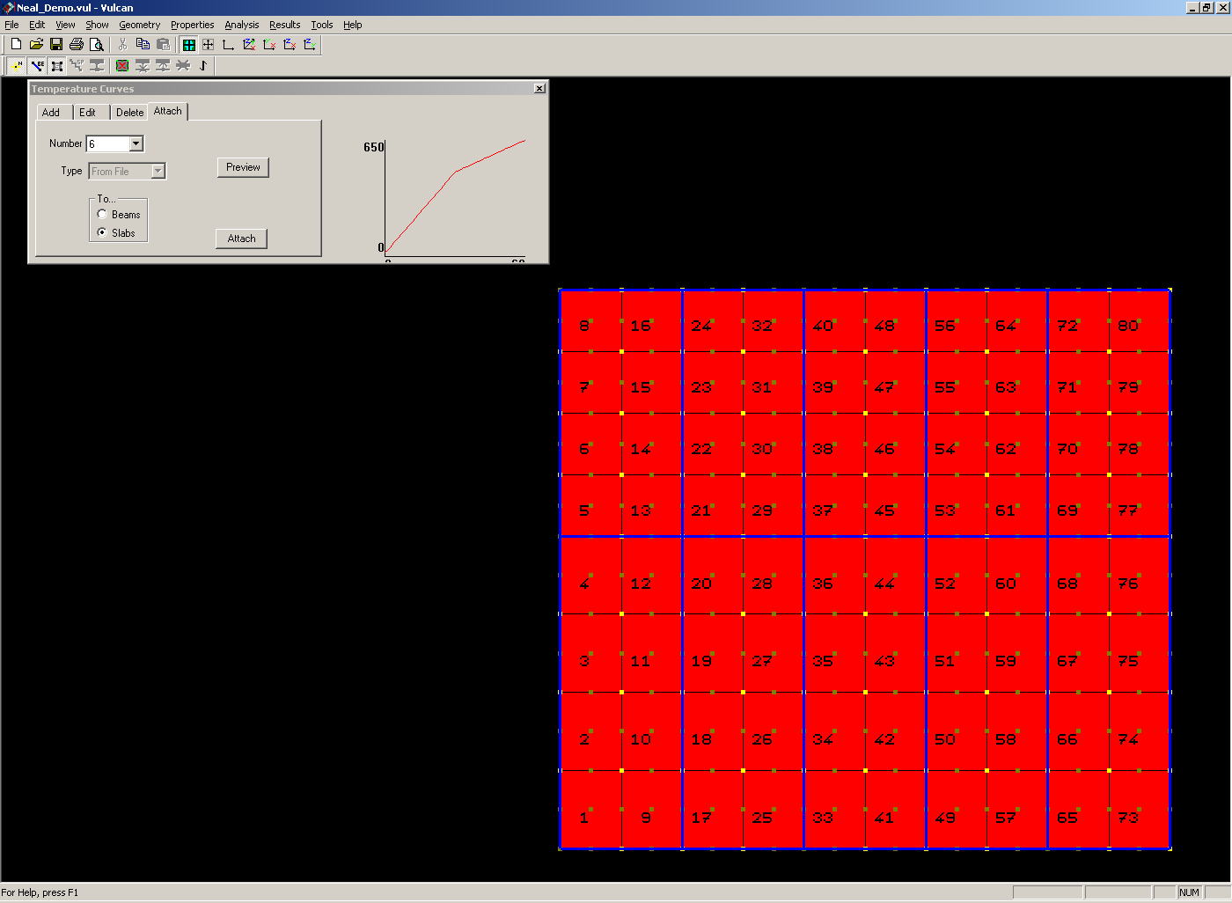
Properties Menu Temperature Curves
1. Define Model
2. Define Protection
3. Generate Grid
4. Add Columns
5. Beam Sections
6. Beams
7. Steel Materials
8. Reinforcement Bars
9. Concrete Sections
10. Concrete Materials
11. Temperature Curves
12. Temperature Patterns
13. Boundary Conditions
14. Loading
15. Output Specification
16. Analysis Parameters
17. Options
18. Analyse
19. Results
Notes:
Slab temperatures are attached as for other members. This is most easily done on plan view.

Slide 68
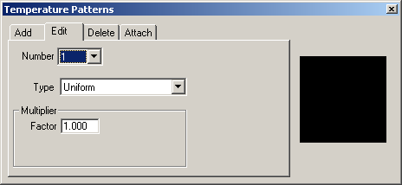
Properties Menu Temperature Patterns
1. Define Model
2. Define Protection
3. Generate Grid
4. Add Columns
5. Beam Sections
6. Beams
7. Steel Materials
8. Reinforcement Bars
9. Concrete Sections
10. Concrete Materials
11. Temperature Curves
12. Temperature Patterns
13. Boundary Conditions
14. Loading
15. Output Specification
16. Analysis Parameters
17. Options
18. Analyse
19. Results
Notes:
The second aspect of defining temperatures in the heated structure is the distribution within the cross-section. Again a number of common cases are included and can simply be selected from a library. The simplest is the case of uniform temperature which applies in the case of fully exposed sections (4-sided attack from the fire) or cold elements (which are not exposed to the fire at all). A factor enables similar temperature patterns to be defined in relation to the same temperature curves, but allowing a different rate of heating. The factor applies to the reference temperature.

Slide 69
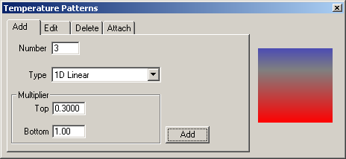
Properties Menu Temperature Patterns
1. Define Model
2. Define Protection
3. Generate Grid
4. Add Columns
5. Beam Sections
6. Beams
7. Steel Materials
8. Reinforcement Bars
9. Concrete Sections
10. Concrete Materials
11. Temperature Curves
12. Temperature Patterns
13. Boundary Conditions
14. Loading
15. Output Specification
16. Analysis Parameters
17. Options
18. Analyse
19. Results
Notes:
Linear temperature distributions through the cross-section are defined by two factors relative to the reference temperature. One factor applies to the hottest surface of the section, the other to the coolest.

Slide 70
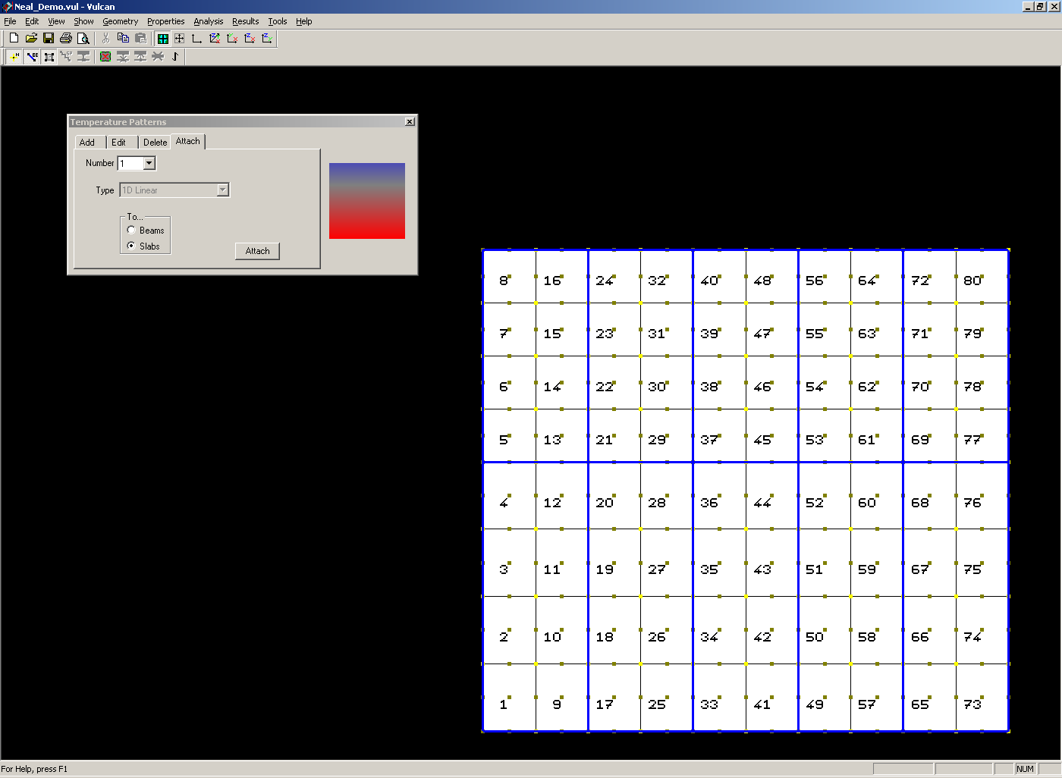
Properties Menu Temperature Patterns
1. Define Model
2. Define Protection
3. Generate Grid
4. Add Columns
5. Beam Sections
6. Beams
7. Steel Materials
8. Reinforcement Bars
9. Concrete Sections
10. Concrete Materials
11. Temperature Curves
12. Temperature Patterns
13. Boundary Conditions
14. Loading
15. Output Specification
16. Analysis Parameters
17. Options
18. Analyse
19. Results
Notes:
Temperature profiles are attached to individual members in a similar way to section sizes.

Slide 71
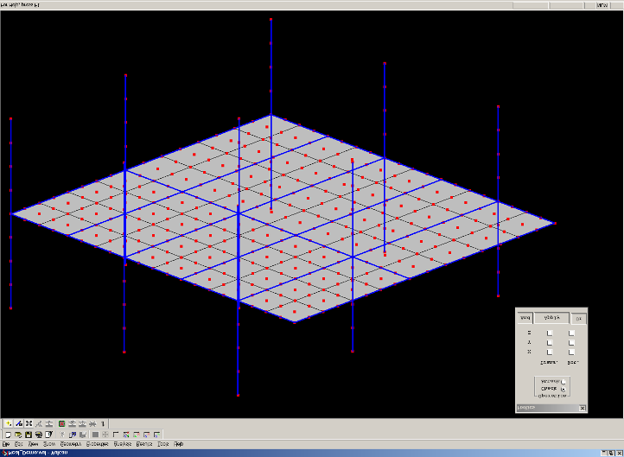
Properties Menu Boundary Conditions
1. Define Model
2. Define Protection
3. Generate Grid
4. Add Columns
5. Beam Sections
6. Beams
7. Steel Materials
8. Reinforcement Bars
9. Concrete Sections
10. Concrete Materials
11. Temperature Curves
12. Temperature Patterns
13. Boundary Conditions
14. Loading
15. Output Specification
16. Analysis Parameters
17. Options
18. Analyse
19. Results
All Free
Notes:
Boundary conditions – from the ‘Properties’ menu
Boundary conditions are defined by fixing individual degrees of freedom at specific nodes. All other nodes are assumed to be free (other than attached to the connecting members attached to the node of course).
To add new boundary restraints click ‘Attach’
To review existing boundary condition click ‘Check’
When the cursor clicks on a specific node in the view the existing the corresponding restraints are displayed in the dialogue box.

Slide 72
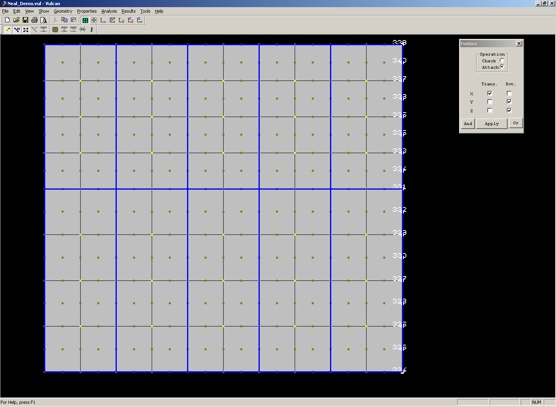
Properties Menu Boundary Conditions
1. Define Model
2. Define Protection
3. Generate Grid
4. Add Columns
5. Beam Sections
6. Beams
7. Steel Materials
8. Reinforcement Bars
9. Concrete Sections
10. Concrete Materials
11. Temperature Curves
12. Temperature Patterns
13. Boundary Conditions
14. Loading
15. Output Specification
16. Analysis Parameters
17. Options
18. Analyse
19. Results
Symmetry
Notes:
Boundary conditions
Boundary conditions are specified from the ‘Properties’ menu by selecting ‘Boundary conditions’. Click on the required nodes on the boundary and tick the boxes corresponding to the externally restrained degrees of freedom at the selected node. Repeat at all supports and where appropriate along lines of symmetry (as shown in this case).

Slide 73
Properties Menu Boundary Conditions
1. Define Model
2. Define Protection
3. Generate Grid
4. Add Columns
5. Beam Sections
6. Beams
7. Steel Materials
8. Reinforcement Bars
9. Concrete Sections
10. Concrete Materials
11. Temperature Curves
12. Temperature Patterns
13. Boundary Conditions
14. Loading
15. Output Specification
16. Analysis Parameters
17. Options
18. Analyse
19. Results
Column Bases - Fixed
Notes:
Boundary conditions
All boundary conditions are specified in a similar manner. In this case column ‘ends’ are being restrained.

Slide 74
Properties Menu Boundary Conditions
1. Define Model
2. Define Protection
3. Generate Grid
4. Add Columns
5. Beam Sections
6. Beams
7. Steel Materials
8. Reinforcement Bars
9. Concrete Sections
10. Concrete Materials
11. Temperature Curves
12. Temperature Patterns
13. Boundary Conditions
14. Loading
15. Output Specification
16. Analysis Parameters
17. Options
18. Analyse
19. Results
Column Heads - Pinned
Notes:
Boundary conditions
It is important that excessive restraint is not specified – this could be beneficial in providing excessive degrees of support, but it could also be very detrimental if it prevents free expansion, thereby developing very high axial compressions and consequently buckling.

Slide 75
Properties Menu Loading
1. Define Model
2. Define Protection
3. Generate Grid
4. Add Columns
5. Beam Sections
6. Beams
7. Steel Materials
8. Reinforcement Bars
9. Concrete Sections
10. Concrete Materials
11. Temperature Curves
12. Temperature Patterns
13. Boundary Conditions
14. Loading
15. Output Specification
16. Analysis Parameters
17. Options
18. Analyse
19. Results
Notes:
Loading menu
Any number of load cases may be specified although in practice a single case is likely to be considered. New load cases are specified using the ‘Add’ tab and the initial dialogue box defines some basic parameters as follows:
Number refers to the load case
Thermal defines the relationship between thermal expansion and temperature for concrete (in practice EC4 – the default - is likely to be sufficient)
Steel defines the basis of the stress-strain-temperature relationship for steel. This will generally be in accordance with EC4 (default), but Ramberg-Osgood may be selected as an alternative.
The remaining information relates to controlling the solution procedures and need not be changed.
Iteration limit– exceptionally the software may not converge at a particular stage of the analysis even though the structure remains stable. Under these circumstances the analysis can proceed to the next iteration using the last converged result as a starting point. This parameter defines how many iterations should be performed before such convergence failure is identified - a value of 250 is recommended
Load increments defines how many load steps are used in the initial ambient temperature analysis – a minimum of 5 is recommended.
Tolerances relate to the analytical processes and there should be no need to alter the default values.
This menu includes general information for each load case.
Gravity loading can be applied as point loads (Point), uniformly distributed floor load intensities (Area), or loads per metre run of a beam (Line).
Slabs can be defined as geometrically non-linear by ticking the box – this would be the normal case.
Description is a free format text box allowing the load case to be labelled.

Slide 76
Properties Menu Loading
1. Define Model
2. Define Protection
3. Generate Grid
4. Add Columns
5. Beam Sections
6. Beams
7. Steel Materials
8. Reinforcement Bars
9. Concrete Sections
10. Concrete Materials
11. Temperature Curves
12. Temperature Patterns
13. Boundary Conditions
14. Loading
15. Output Specification
16. Analysis Parameters
17. Options
18. Analyse
19. Results
Notes:
Loading
This is defined from the ‘Properties’ menu in the ‘Loading’ dialogue box. For uniformly distributed loads on a floor select ‘area’, enter the load intensity and ‘attach’ this to selected areas of floor on the screen view.

Slide 77
Properties Menu Loading
1. Define Model
2. Define Protection
3. Generate Grid
4. Add Columns
5. Beam Sections
6. Beams
7. Steel Materials
8. Reinforcement Bars
9. Concrete Sections
10. Concrete Materials
11. Temperature Curves
12. Temperature Patterns
13. Boundary Conditions
14. Loading
15. Output Specification
16. Analysis Parameters
17. Options
18. Analyse
19. Results
Notes:
Columns loads
Columns loads may need to be specified where an intermediate floor is considered as a subframe. In such cases columns will be subject to axial loads from the upper floors, and these should be entered as point loads.

Slide 78
Analysis Menu Output Specification
1. Define Model
2. Define Protection
3. Generate Grid
4. Add Columns
5. Beam Sections
6. Beams
7. Steel Materials
8. Reinforcement Bars
9. Concrete Sections
10. Concrete Materials
11. Temperature Curves
12. Temperature Patterns
13. Boundary Conditions
14. Loading
15. Output Specification
16. Analysis Parameters
17. Options
18. Analyse
19. Results
Notes:
Output specification
To avoid generating and saving vast amounts of data it is possible to be selective about the information which should be saved. This makes subsequent processing and interpretation of results much easier. Typically the most useful data relates to the vertical deflection in key elements, and the lateral deflection in columns.

Slide 79
Analysis Menu Output Specification
1. Define Model
2. Define Protection
3. Generate Grid
4. Add Columns
5. Beam Sections
6. Beams
7. Steel Materials
8. Reinforcement Bars
9. Concrete Sections
10. Concrete Materials
11. Temperature Curves
12. Temperature Patterns
13. Boundary Conditions
14. Loading
15. Output Specification
16. Analysis Parameters
17. Options
18. Analyse
19. Results
Notes:
This identifies the specific data to be recorded in the output file. Information regarding displacements, forces, cracking, and temperatures can be selected by clicking the appropriate tab and specifying the particular information required.

Slide 80
Analysis Menu Analysis Parameters
1. Define Model
2. Define Protection
3. Generate Grid
4. Add Columns
5. Beam Sections
6. Beams
7. Steel Materials
8. Reinforcement Bars
9. Concrete Sections
10. Concrete Materials
11. Temperature Curves
12. Temperature Patterns
13. Boundary Conditions
14. Loading
15. Output Specification
16. Analysis Parameters
17. Options
18. Analyse
19. Results
Notes:
These are optional selections associated with temporary file storage and it is recommended that the defaults are normally used.

Slide 81
Tools Menu Options
1. Define Model
2. Define Protection
3. Generate Grid
4. Add Columns
5. Beam Sections
6. Beams
7. Steel Materials
8. Reinforcement Bars
9. Concrete Sections
10. Concrete Materials
11. Temperature Curves
12. Temperature Patterns
13. Boundary Conditions
14. Loading
15. Output Specification
16. Analysis Parameters
17. Options
18. Analyse
19. Results
Notes:
These are optional selections and it is recommended that the defaults are normally used

Slide 82
Analysis Menu Analyse
1. Define Model
2. Define Protection
3. Generate Grid
4. Add Columns
5. Beam Sections
6. Beams
7. Steel Materials
8. Reinforcement Bars
9. Concrete Sections
10. Concrete Materials
11. Temperature Curves
12. Temperature Patterns
13. Boundary Conditions
14. Loading
15. Output Specification
16. Analysis Parameters
17. Options
18. Analyse
19. Results
Notes:
Once the input is complete and the required output has been specified the analysis can start. This is done by selecting the ‘Analysis’ menu and clicking ‘Go’.

